Slide 1
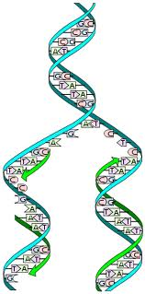
DNA
Chapter 26 and 28
Ted-Ed “Book of You”
Notes:
http://ed.ted.com/lessons/dna-the-book-of-you-joe-hanson

Slide 2
DNA Replication ANIMATION
  DNA making identical copies of itself
  Inherent in DNA’s structure is a mechanism for reproducing itself. Before a cell can divide, all of the DNA must be duplicated.
  This duplication process is called REPLICATION.
Notes:
http://highered.mcgraw-hill.com/olcweb/cgi/pluginpop.cgi?it=swf::535::535::/sites/dl/free/0072437316/120076/micro04.swf::DNA%20Replication%20Fork

Slide 3
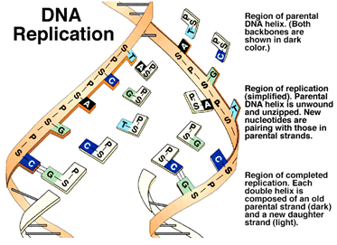

Slide 4
each strand of DNA can be viewed as a template:
like a potter's mold, it can produce a "reverse image" copy of itself (a complementary copy).
Each new strand of DNA produced has a sequence of bases exactly complementary to the template strand

Slide 5
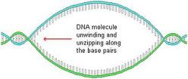
Sequence of Events in Replication:
UNZIPPING: the DNA double helix unwinds, and the two strands of DNA separate; hydrogen bonds between the bases break
Enzyme = DNA Helicase
Notes:
DNA helicase = unwinds the DNA

Slide 6
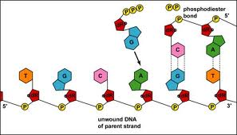
COMPLEMENTARY BASE PAIRING:
  new nucleotides move in to pair up with bases of each template strand of DNA. These new nucleotides are always floating around within the nucleoplasm.
  Enzyme = DNA polymerase
Notes:
DNA polymerase = puts bases together

Slide 7
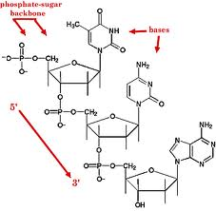
3. ADJACENT NUCLEOTIDES BOND:
sugar-phosphate bonds form between adjacent nucleotides of the new strand to complete the molecule. The new molecule winds into a double helix.
Enzyme = DNA ligase
Notes:
DNA ligase = puts backbone back together

Slide 8
• each new strand of DNA produced contains one "old" strand (the template) and one new strand. This is known as "SEMI-CONSERVATIVE" replication. Since half of the original molecule is conserved in each of the new molecules, this ensures that there will be very, very accurate replication of the parent molecule.
• this process proceeds by the action of several very specific enzymes (e.g. DNA Polymerases, gyrase, helicase)
• product of replication by one DNA molecule is two complete double-stranded DNA molecules, each with one new strand and one original stand that acted as a template for replication. ANIMATION
Notes:
http://www.johnkyrk.com/DNAreplication.html

Slide 9
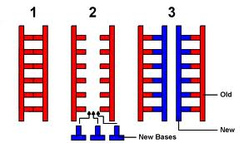

Slide 10
Ted-Ed “Human Genome”
Ted-Ed “Twisting Tale”
Ted-Ed “Chicken or the Egg?”
Notes:
http://ed.ted.com/lessons/how-to-sequence-the-human-genome-mark-j-kiel
http://ed.ted.com/lessons/the-twisting-tale-of-dna-judith-hauck
http://ed.ted.com/featured/jOuJyFNt

Slide 11
D3-D4: Recombinant DNA
I. Recombinant DNA
Use of various techniques and enzymes to recombine DNA from different organisms
Genes from one species can be cut out and inserted into the DNA of an entirely different species
C. The new gene can then be expressed by the
recipient species

Slide 12
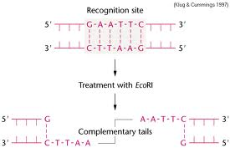
Recombinant DNA technology involves the use of special enzymes as tools:
  Restriction enzymes cleave DNA at specific sites
  2. Other enzymes such as DNA polymerase, Ligase, Reverse transcriptase
Notes:
Enzymes usually end with ending -ase

Slide 13
Uses for Recombinant DNA
There are many possibilities for uses of recombinant DNA:
  1. Protein production
  It is possible to isolate a gene from one organism (e.g. Human insulin), and using recombinant DNA techniques, insert that gene into a different organism (e.g. E. coli) ANIMATION
  b. The new organism can then produce that protein
  c. By culturing large quantities of the bacteria it is possible to collect large amounts of Human insulin inexpensively
  d. Many other useful human proteins are being produced in this manner (interferon, Growth Hormone, interleukins etc.)
Notes:
http://www.bioteach.ubc.ca/TeachingResources/Applications/GMOpkgJKloseGLampard2.swf

Slide 14
2. Gene therapy
  It is possible to correct genes in individuals that have non-functional (mutated) genes
  Example: the corrected gene for the protein that, when mutant, causes Cystic Fibrosis has been inserted into a virus that infects human lung cells (the virulent parts of the virus genes have been deactivated)
  The virus then injects the corrected cystic fibrosis gene into the cells of the cystic fibrosis patient, and their symptoms are greatly reduced! ANIMATION & ANIMATION
Notes:
http://www.youtube.com/watch?v=t1pN9OHRukw
http://www.sumanasinc.com/scienceinfocus/sif_genetherapy.html

Slide 15
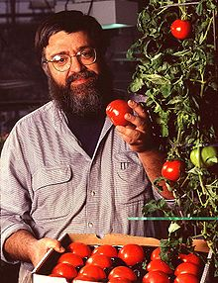
Transgenic organisms
a. Selected genes can be inserted into a plant to give it features that were not possible through breeding ANIMATION
The Flavrsavr tomato!
The first transgenic crop to be approved in US
The tomato was made more resistant to rotting by adding an antisense gene which interferes with the production of the enzyme polygalacturonase. The enzyme normally degrades pectin in the cell walls and results in the softening of fruit which makes them more susceptible to being damaged by fungal infections. The modified tomatoes are picked before fully ripened and are then artificially ripened using ethylene gas which acts as a plant hormone.
Notes:
http://www.pbs.org/wgbh/harvest/engineer/transgen.html

Slide 16
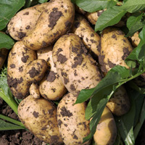
b. Example: a bacterial insect toxin (Bacillus thuringiensis) gene can be inserted into a plant (eg. potato) so the plant is now toxic to insects, and fewer insecticides are needed in order to grow it!
NewLeaf^{tm} Potato is resistant to the
Colorado Potato Beetle

Slide 17
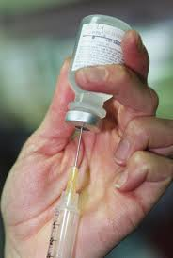
4. Safer Vaccines
4. Safer Vaccines
a. vaccines: historically made with treated
pathogens
b. some “treated” vaccines not attenuated
enough, and caused the disease!
c. can make vaccines out of only the surface
proteins from these pathogens (which is what human antibodies would normally bind to, anyway) to train immune system to ‘recognize’ and attack these pathogens without risking exposure to the actual pathogen
(Many more examples: Mader Chapter 24)

Slide 18
III. Techniques of Genetic Engineering
A "vector" is something that can get the DNA from one species into the other species' DNA.
Often, this can be a "plasmid", a circular piece of DNA found in some bacteria.

Slide 19
3. A human gene, such as the gene for insulin, is inserted into the plasmid and then the plasmid is taken up by bacteria. The bacteria reproduces the plasmid along with its own DNA when it reproduces, and translates the human gene, producing human protein.
4. This technique can be used to produce cloned DNA by allowing the bacteria to multiply themselves. ANIMATION
Notes:
http://www.sumanasinc.com/webcontent/animations/content/plasmidcloning.html

Slide 20
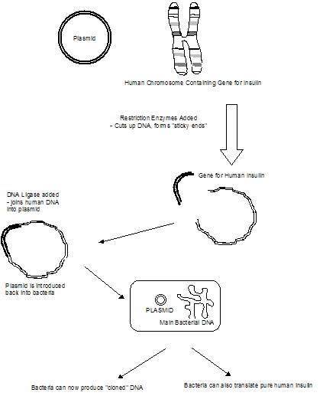

Slide 21
B. Polymerase Chain Reaction (PCR)
PCR can also make large amounts of a desired gene or piece of DNA.
2. PCR can be done without bacteria, inside test tubes, and can amplify billions of times samples with very little DNA (e.g. a single hair from a crime scene, or inside some fossils).

Slide 22
3. PCR makes huge amounts of any gene, quickly by:
  a. Heat the DNA to about 93ºC, which unwinds the DNA and separates the two strands.
  b. Add some replication primers, and allow to cool
  c. Add heat resistant DNA polymerase (Taq polymerase) (the replication enzyme) and free nucleotides. The DNA will copy itself.
  d. Heat and repeat. The DNA will go on doubling itself each “generation”.

Slide 23
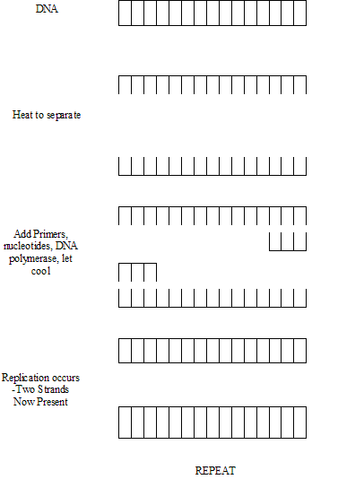
ANIMATION
Notes:
http://www.sumanasinc.com/webcontent/animations/content/pcr.html

Slide 24
4. After PCR has been performed, a variety of thing can be done:
  Sequence of bases on DNA can be determined (e.g. using the “Sanger Method”) and is useful for:
      i. Study evolutionary relationships between organisms (e.g. humans and chimpanzees), and trace the origin of human races.
      ii. Map every single nucleotide on all human chromosomes (“the Human Genome Project”)

Slide 25
b. DNA can be analyzed using a DNA probe ANIMATION
  i. DNA probe is a specially synthesized single strand of radioactive DNA nucleotides that will bind to a complementary DNA strand on the DNA being tested.
  ii. This can be used to detect viral infections, diagnose genetic disorders, and diagnose some cancers.

Slide 26
c. Comparing DNA from two different organisms by using RFLP analysis. (Restriction Fragment Length Polymorphisms)
  This can provide a “DNA fingerprint” that is unique to each individual (except identical twins).
  RFLP analysis uses specific restriction enzymes that cut DNA at specific sequences.
  This produces fragments that, when separated using gel electrophoresis, produce patterns of bands that can be compared to another person’s pattern of bands ANIMATION

Slide 27
If the band pattern is identical, the DNA must have come from the same person.
This can be used to identify a criminal from a blood or semen stain. It can also determine who the father of a child is, with a high degree of accuracy.
ANIMATION

Slide 28
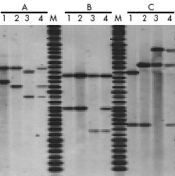
Paternity testing by RFLP
Analysis
Three paternity cases tested with DNA from blood samples.
Mother
Child
Alleged father
Child + Alleged father
M. DNA markers
Outcome A – alleged father excluded
Outcome B – alleged father excluded
Outcome C – Alleged father confirmed

Slide 29
  RFLP analysis is also used to see whether a person carries a gene for a genetic disorder like cystic-fibrosis or sickle-cell anemia, and can be used for prenatal diagnosis.
  vii. RFLP analysis also contributes to our knowledge of evolution and evolutionary relationships by comparing human and animal DNA.
  ELSI ANIMATION

Slide 30
RNA: RIBONUCLEIC ACID :
how DNA communicates its message.
RNA is the genetic material of some viruses and is necessary in all organisms for protein synthesis to occur. RNA could have been the “original” nucleic acid when life first arose on Earth some 3.8 billion years ago.
Like DNA, all RNA molecules have a similar chemical organization, consisting of nucleotides.

Slide 31
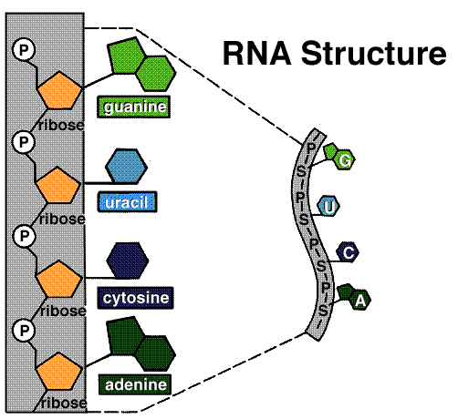
Like DNA, each RNA nucleotide is also composed of three subunits:
  a 5-carbon sugar called RIBOSE.
  a PHOSPHATE group that is attached to one end of the sugar molecule
  3. one of several different nitrogenous BASES linked to the opposite end of the ribose.

Slide 32
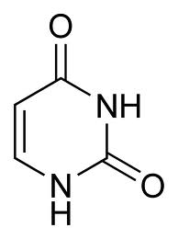
There is one base that is different from DNA -- the base Uracil is used instead of thymine.(G, A, C, are otherwise the same as for DNA)
RNA is SINGLE-STRANDED, unlike DNA which is double stranded. RNA, therefore, is not a double helix.
Uracil

Slide 33
• RNA is produced from DNA by a process called TRANSCRIPTION. The steps of transcription are as follows:
  1. A specific section of DNA unwinds, exposing a set of bases
  2. Along one strand of DNA (called the "sense" strand), complementary RNA bases are brought in. In RNA, Uracil binds to the Adenine on DNA. As in DNA, cytosine binds to guanine. The other strand of the DNA molecule (the “missense” strand), isn’t read in eukaryotic cells.
  3. Adjacent RNA nucleotides form sugar-phosphate bonds.
  4. The RNA strand is released from DNA (RNA is a single-stranded nucleic acid).
  5. The DNA molecule rewinds, and returns to its normal double helix form. ANIMATION

Slide 34
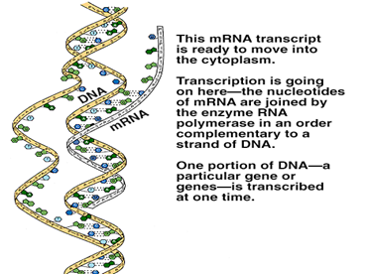

Slide 35
Once produced, the mRNA strand is often processed (certain sections called introns are cut out, a "Poly-A" tail is added to the 3' end, and a "cap" is added to the 5' end). Poly-A ANIMATION
  Splicing ANIMATION
RNA can then leave the nucleus and go into the cytoplasm.
The enzyme involved in transcription is known as RNA polymerase.
  This process occurs in the nucleus (and, in particular, dark coloured spots in the nucleus called nucleoli (singular = nucleolus)

Slide 36
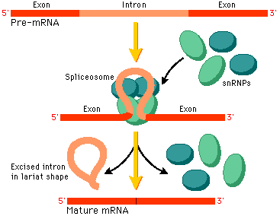

Slide 37
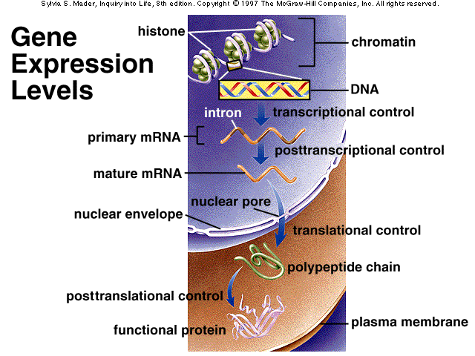

Slide 38
Please transcribe the following DNA strand
G | A | C | A | A | C | T | G | G | A | T | C | G | A | C | DNA
III | II | III | II | II | III | II | III | III | II | II | III | III | II | III
 |  |  |  |  |  |  |  |  |  |  |  |  |  |  | mRNA

Slide 39
G | A | C | A | A | C | T | G | G | A | T | C | G | A | C | DNA
III | II | III | II | II | III | II | III | III | II | II | III | III | II | III
C | U | G | U | U | G | A | C | C | U | A | G | C | U | G | mRNA

Slide 40
There are 3 types of RNA, each with different functions.
rRNA
tRNA
mRNA
– The agents of Protein Synthesis
RNA that is involved in protein synthesis belongs to one of three distinct types:
ribosomal RNA (rRNA),
transfer RNA (tRNA),
messenger RNA (mRNA).

Slide 41
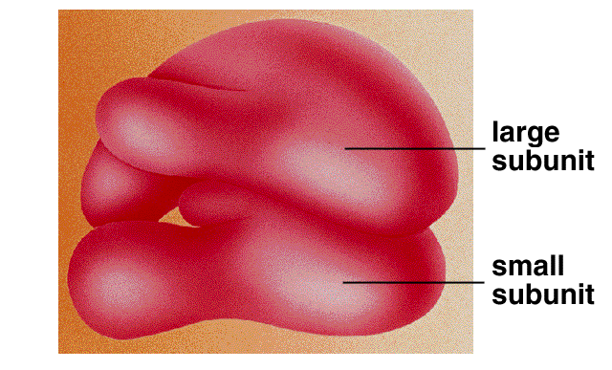
RIBOSOMAL RNA (rRNA)
becomes a structural part of ribosomes and serves as a genetic link between mRNA and tRNA. Ribosomal RNA is associated with protein, forming bodies called ribosomes.
Ribosomes are the sites of protein synthesis.
Notes:
. Ribosomal RNA provides a mechanism for decoding mRNA into amino acids and interacts with tRNAs during translation by providing peptidyl transferase activity. The tRNAs bring the necessary amino acids corresponding to the appropriate mRNA codon.

Slide 42
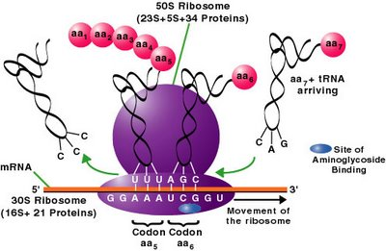
Ribosomal RNA varies in size and is the most plentiful RNA. It constitutes 85% to 90% of total cellular RNA.

Slide 43
Transfer RNA (tRNA) - is used to deliver amino acids from the cytoplasm to the ribosome.
There is a different tRNA for each amino acid. The function of each type of tRNA is to bring its specific amino acid to a ribosome.
The tRNA molecules consist of about 80 nucleotides and are structured in a cloverleaf pattern. They constitute about 5% of the cell's total RNA.

Slide 44
Messenger RNA (mRNA) - carries the genetic code contained in the sequence of bases in the cell's DNA from the nucleus to the Ribosome.
mRNA: acts as a "go-between" for DNA in the nucleus and the ribosomes in the cytoplasm.
mRNA constitutes 5% to 10% of the cell's RNA.

Slide 45
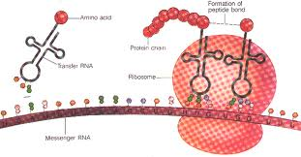

Slide 46
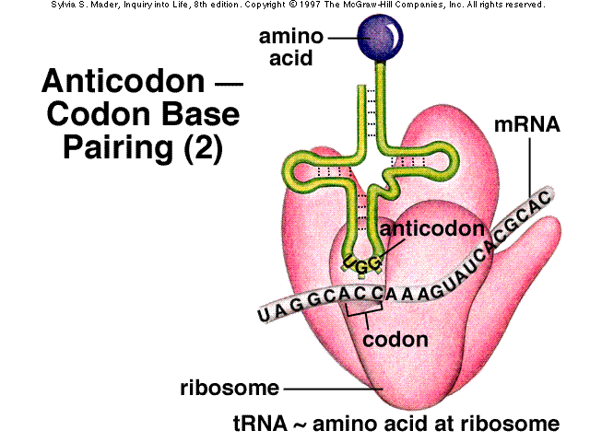

Slide 47
The Central Dogma of Molecular Biology
DNA → → mRNA → → Protein ANIMATION
transcription translation
mRNA, once produced, leaves the nucleus through pores in the nuclear envelope, and enters the cytoplasm. This is where TRANSLATION occurs.
Translation is the process that changes the RNA message into the actual protein. It occurs at the surface of the RIBOSOME.

Slide 48
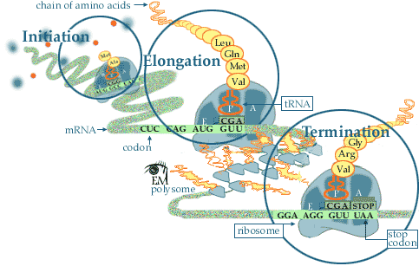

Slide 49
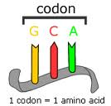
The order of the bases in DNA, and then subsequently mRNA, determines the amino acid sequence of the protein being made.
Each amino acids is coded for by 3 bases (this is known as a TRIPLET CODE)
There are 20 different amino acids, but only 4 different bases in DNA/RNA.
Each three-letter unit of mRNA is called a CODON.

Slide 50
There are 4³ ( = 64) codons possible --> therefore there are easily enough codons to code for all the necessary amino acids.
In fact, the same amino acid is often specified by more than one codon. However (and this is very important), the reverse is never true: that is, any one codon only specifies ONE amino acid -- there is no vagueness in the code (e.g. CCU will always produce proline).
The code also contains “punctuation.” It tells when to start reading the gene for a particular protein and when to stop.

Slide 51
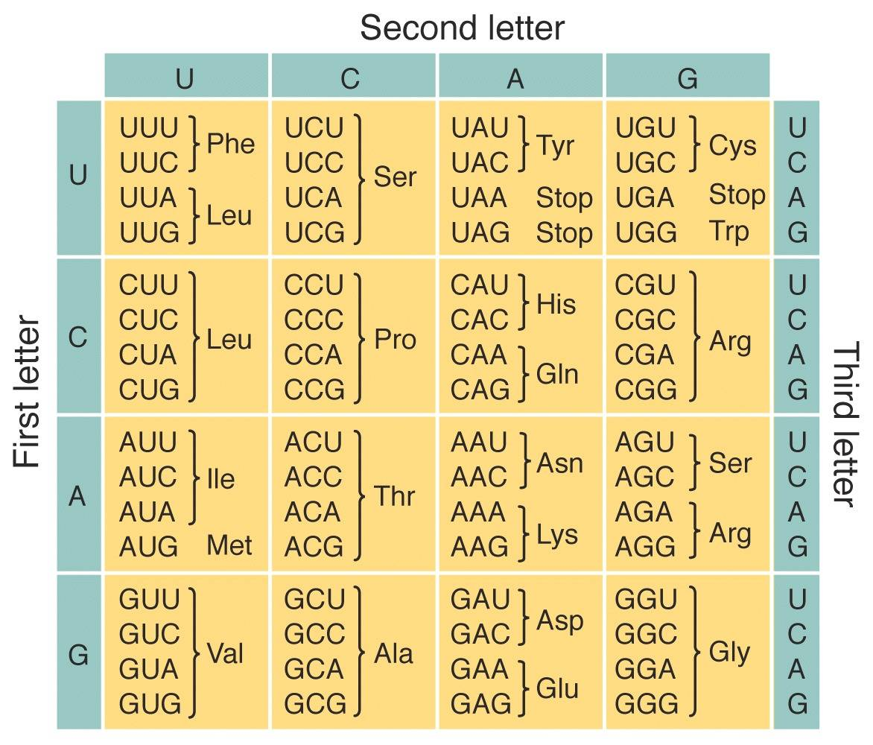
Each codon corresponds to an amino acid, or a "start" or "stop" synthesis signal. And here it is, the most important chart in all of Biology: the GENETIC CODE!

Slide 52
The genetic code is universal: the same codons stand for the same amino acids in all living things (well, almost all living things).
This "Biochemical Unity" suggests that all living things have a common evolutionary ancestor.

Slide 53
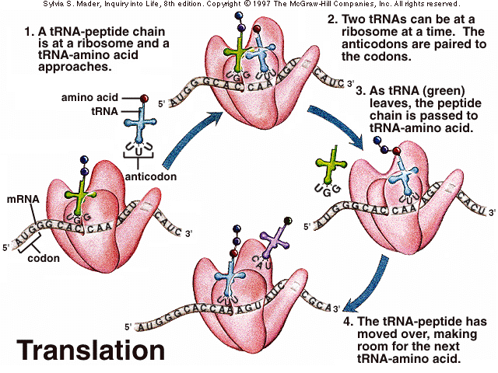
Translation
Human Genome Video

Slide 54
The steps in Translation: can be divided into 3 subprocesses:
  Initiation
  Elongation
  Termination

Slide 55
1. Initiation - : the mRNA, with its START CODON (AUG) attaches to the "R" site of the ribosome.
RBS a short sequence
Located upstream of the
Initiation codon sequence
Start codon
AUG
mRNA

Slide 56
A small ribosomal subunit binds to mRNA.
RBS a short sequence
Located upstream of the
Initiation codon sequence
Start codon
AUG
mRNA

Slide 57
met
tRNA with a complementary
anticodon (UAC)pairs with the
initiation codon (AUG)
the amino acid methionine is
bound to the tRNA
UAC
AUG

Slide 58
At the same time the large ribosomal subunit binds
met
UAC
AUG

Slide 59
met
A – site is a second binding site where tRNA can attach to the next codon
UAC
AUG AAA
P-site on ribosome is a binding site where the tRNA attaches
R Site on ribosome binds to RBS

Slide 60
met
lys
UAC
UUU
AUG AAA
Another tRNA binds to the A site where the next codon is located

Slide 61
INITIATION: the mRNA, with its START CODON (AUG) attaches to the "R" site of the ribosome.
The AUG codon always initiates translation and codes for the amino acid methionine.
tRNA binds to the start codon of mRNA. The tRNA has a binding site of 3 bases called an ANTICODON that is complementary to the mRNA codon. Therefore, the codon of mRNA of AUG is "read" by a tRNA that has a UAC anticodon. The tRNA that has this anticodon carries, at it's tail, the amino acid methionine.
This methionyl-tRNA is in the P site of the ribosome. The A site next to it is available to the tRNA bearing the next amino acid.
There is a specific tRNA for each mRNA codon that codes for an amino acid.

Slide 62
Elongation
Peptide bond
forms between
amino acids
met
lys
UAC
UUU
AUG AAA

Slide 63
Elongation
met
lys
UAC
UUU
AUG AAA
Ribosome moves forward and the binding sites are translocated

Slide 64
Elongation
met
lys
UUU
AUG AAA AGA

Slide 65
more amino acids are added and connected together to form a polypeptide, as specified by the mRNA sequence.
  an incoming amino-acyl-tRNA (lets call this AA₂-tRNA₂) recognizes the codon in the A site and binds there.
  a peptide bond is formed between the new amino acid and the growing polypeptide chain.
  c. the amino acid is removed from tRNA₁ (bond breaks between aa₁ and tRNA₁)

Slide 66
  the tRNA₁ that was in the P site is released, and the tRNA in the A site is translocated to the P site.
  the ribosome moves over one codon along the mRNA (to the right in our diagram, or more specifically in the 5' ----> 3' direction.)
  This movement shifts the tRNA₂ (which is attached to the growing amino acid chain) to the P site.

Slide 67
Elongation
met
lys
ser
UUU
UCU
AUG AAA AGA

Slide 68
  tRNA₃ with aa₃ can now move into A site and bind with the next codon on mRNA.
  h. THIS PROCESS REPEATS, and the CHAIN ELONGATES as long as there are new codons to read on the mRNA.

Slide 69
TERMINATION: The process above repeats until a special codon, called a STOP CODON, is reached. There are 3 Stop codons: UAA, UAG, UGA.
  the stop codons do not code for amino acids but instead act as signals to stop translation.
  b. a protein called release factor binds directly to the stop codon in the A site. The release factor causes a water molecule to be added to the end of the polypeptide chain, and the chain then separates from the last tRNA.
  .

Slide 70
  the protein is now complete. The mRNA is now usually broken down, and the ribosome splits into its large and small subunits.
  d. the new protein is sent for final processing into the endoplasmic reticulum and golgi apparatus

Slide 71
Termination
met
lys
ser
Release
Factor
UCU
AUG AAA AGA UGA

Slide 72
The release factor
Comes to a stop codon on the mRNA and binds to the site
Hydrolyzes the bond between the last tRNA at the P site and the polypeptide. This releases them
The ribosomal subunits dissociate

Slide 73
Termination
met
lys
ser
Release
Factor
UCU
AUG AAA AGA UGA

Slide 74
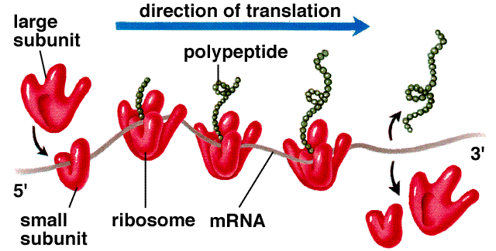

Slide 75

Often, many ribosomes will simultaneously transcribe the same mRNA. In this way, many copies of the same protein can be made quickly. These clusters of ribosomes are called polysomes.

Slide 76
Working Example!
Translating DNA into proteins
Given the following DNA nucleotide sequence:
TGTCAACGTACTG
Give the mRNA sequence that would be transcribed from it!

Slide 77
Working Example!
Translating DNA into proteins
Given the following DNA nucleotide sequence:
TGTCAACGTACTG
Give the mRNA sequence that would be transcribed from it!
ACAGUUGCAUGAC

Slide 78
Give the mRNA codons
Give the tRNA anticodons

Slide 79
Give the mRNA codons
ACA GUU GCA UGA C
Give the tRNA anticodons

Slide 80
Give the mRNA codons
ACA GUU GCA UGA C
Give the tRNA anticodons
  UGU CAA CGU ACU G

Slide 81
4. Give the amino acid sequence that would be translated from it.
a. Take your mRNA codons
ACA GUU GCA UGA C
b. Refer to Fig. 24.8 p 492

Slide 82
4. Give the amino acid sequence that would be translated from it.
a. Take your mRNA codons
ACA GUU GCA UGA C
b. Refer to Fig. 24.8 p 492
Threonine – Valine – Alanine - Stop

Slide 83
II. Determining DNA sequences from Proteins
Given the following amino acid sequence, give a possible DNA sequence that could code for the sequence:
Lysine, Asparanine, Methionine, Glutamic Acid, Alanine, Stop.

Slide 84
Lysine, Asparagine, Methionine, Glutamic Acid, Alanine, Stop.
Step 1
Look up codons on fig. 24.8
Lys – Asp - Met - Glu - Ala – Stop
AAA – AAU – AUG – GAA – GCU - UAA
AAG AAC GAG GCC - UAG
GCA UGA
GCG
There are multiple codons for Asparagine, Glutamate , Alanine and stop

Slide 85
Find the complementary base pairs and remember that Uracil is not a base in DNA.
AAA-AAU-AUG-GAA-GCU-UAA - mRNA
TTT-TTA-TAC-CTT-CGA-ATT - DNA

Slide 86

E3-E4: Mutations
Amoeba sisters: Mutations Animation
I. MUTATIONS & DEFECTS
Chromosomal abnormalities
Karyotype Activity
  1. Recall: during meiosis, homologous chromosomes (doubled, earlier in the process) line up at the center of the cell and engage in “crossing over” (increases variety of gene combinations)…

Slide 87
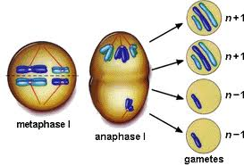
2. Problems occasionally arise, causing changes in the physical structure of a chromosome
i) Usually involves thousands of genes
i) homologues get stuck together, and don’t separate (called “non-disjunction”)
a) in sex chromosomes …
b) in autosomes

Slide 88
Non disjunction in sex chromosomes
Sex chrom.s of defective sperm | Sex chroms. Of normal egg | Sex chrom.s of fetus | Phenotype of offspring
O | X | XO | F-Turner Syndrome
XX | X | XXX | F – Trisomy X
YY | X | XYY | M – XYY males
XY | X | XXY | M – Klinefelter Syndrome

Slide 89
Sex chrom.s of defective egg | Sex chroms. Of normal sperm | Sex chrom.s of fetus | Phenotype of offspring
O | X | XO | F – Turner Syndrome
O | Y | YO | fatal
XX | X | XXX | F – trisomy X
XX | Y | XXY | M –Klinefelter Syndrome

Slide 90
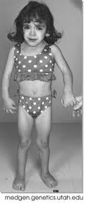
Turner Syndrome (XO)
Characteristics:
Swollen hands and feet (child)
Webbed neck (child)
Incomplete puberty
Broad shield-like chest
Drooping eyelids
Dry eyes
Infertility
Short
Absence of menstruation

Slide 91
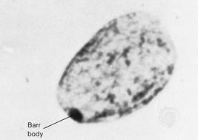
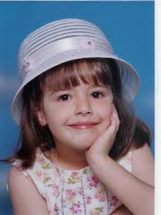
Trisomy X
Due to the deactivation of X-chromosomes and the formation of Barr bodies, only one X-chromosome is active in any given cell.
Therefore, most girls with trisomy X are unaffected by the extra X chromosome.

Slide 92
XYY (Jacobs Syndrome)
Taller
May have persitant acne
Tend to have speech and reading problems
Once thought to be aggressive – since disproven

Slide 93
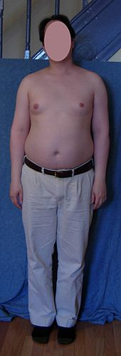
XXY – Klinefelter Syndrome
Abnormal body proportions (long legs, short trunk, shoulder equal to hip size)
Abnormally large breasts
Infertility
Sexual problems
Less than normal amount of pubic, armpit, and facial hair
Small testicles
Tall height

Slide 94
b) in autosomes:
1) results in gametes that are:
    missing the chromosome in question
    have 2 copies of chrom. in question
2) when fused w/ normal gamete, zygote
  has either 1 or 3 copies of chromosome in question
    3) 1 copy = fatal; embryo aborts so early that
woman never knows she was pregnant
4) 3 copies = fatal in most cases; miscarriage later in pregnancy: exceptions: trisomy 13, 18 may make the full 40 weeks and be born; trisomy 21 (Down Syndrome)

Slide 95
c) non-disjunction influenced by age of parents,
esp. mother …
1) a woman’s eggs begin to develop in her ovaries when she is still a fetus in her mother’s uterus!
Over 35, non-disjunction risk rises exponentially
2) male “age effect” is smaller (meiosis cycle about 2 weeks) (about 25% of Down Syn. Cases)
c) non-disjunction influenced by age of parents,
esp. mother …
1) a woman’s eggs begin to develop in her ovaries when she is still a fetus in her mother’s uterus!
Over 35, non-disjunction risk rises exponentially
2) male “age effect” is smaller (meiosis cycle about 2 weeks) (about 25% of Down Syn. Cases)

Slide 96
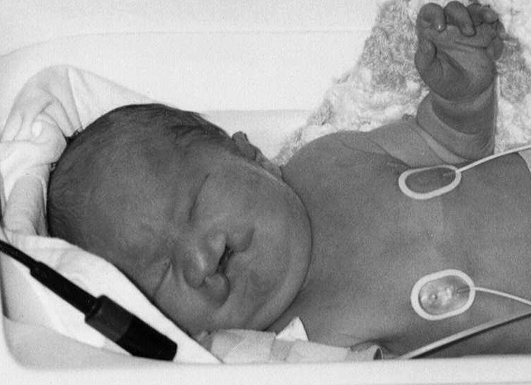

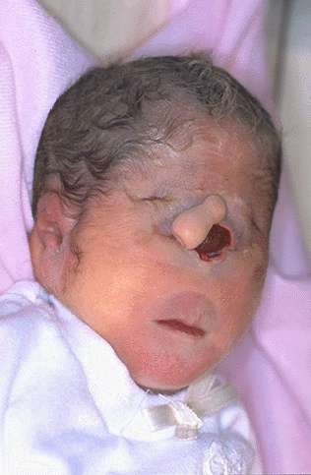
Trisomy 13 - Patau Syndrome
Cleft lip or palate
Clenched hands (with outer fingers on top of the inner fingers)
Close-set eyes -- eyes may actually fuse together into one
Decreased muscle tone
Extra fingers or toes
Hernias:
Hole, split, or cleft in the iris
Low-set ears
Mental retardation, severe
Scalp defects (missing skin)
Seizures
Single palmar crease
Skeletal (limb) abnormalities
Small eyes, head and lower jaw
Unusual to survive past 1st birthday

Slide 97
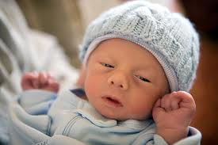
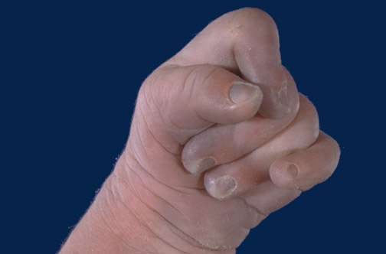
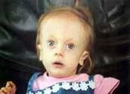
Trisomy 18 – Edwards Syndrome
Clenched hands
Crossed legs (preferred position)
Feet with a rounded bottom (rocker-bottom feet)
Low birth weight
Low-set ears
Mental deficiency
Small head
Small jaw
Underdeveloped fingernails
Undescended testicle
Unusual shaped chest
50% of infants do not survive past 1 week. Some make it into teenage years with serious developmental and medical problems

Slide 98
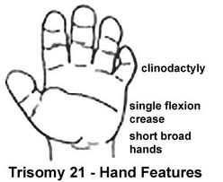
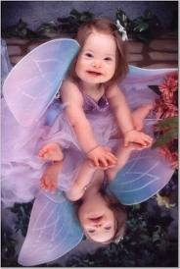
Trisomy 21 – Down Syndrome
Decreased muscle tone at birth
Excess skin at the nape of the neck
Flattened nose
Separated joints between the bones of the skull (sutures)
Single crease in the palm of the hand
Small ears
Small mouth
Upward slanting eyes
Wide, short hands with short fingers
White spots on the colored part of the eye
Impulsive behavior
Poor judgment
Short attention span
Slow learning

Slide 99
B. Chromosomal Mutations
Def’n: change in chromosome structure that can be detected microscopically
1. Segments of chromosomes can be affected
    (in crossing over, or break due to radiation, chemicals, viruses…) and change the gene sequence of that chromosome
2. Results: missing genes, extra copies of genes,or “garbling” of base-pair sequences

Slide 100
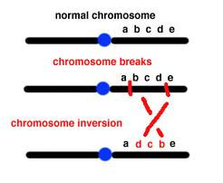
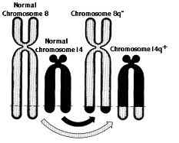
i)Flipped-over pieces (“inversion”)
ii) Exchange of pieces with a non-homologue (“translocation”)

Slide 101
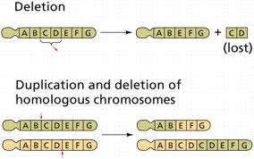
iii) Exchange of pieces with a homologue (“duplication”)
iv) Missing pieces from two close breaks that closes up, leaving a missing piece behind (called “deletion”)

Slide 102
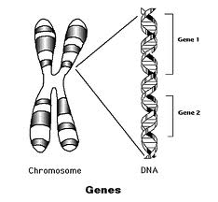
C. Gene Mutations
1. GENE (def’n) the segment of DNA on a chromosome that codes for ONE protein
2. Gene Mutation (def’n) change in the nucleotide sequence of a gene

Slide 103
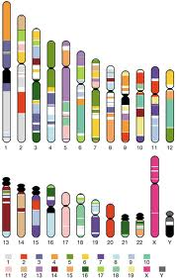
3. The human genome (all the DNA in all 46 chromosomes in one human cell) is approximately 3 billion base pairs -- only 10 - 15 % of this DNA is actual genes

Slide 104
Types of gene mutation:
a) FRAMESHIFT mutations: caused by insertions
or deletions in the base-pair sequence
i) effect how the codons are read:
e.g.: THE MAN BIT THE DOG
delete the first H, and this becomes:
TEM ANB ITT HED OG_
ii) result: a completely non-functioning protein; all amino acids are wrong

Slide 105
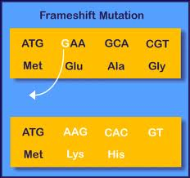

Slide 106
b) POINT mutations: a change in a single nucleotide, resulting in a change of one codon
i) results vary…
1) SILENT mutation: no effect on protein
e.g.: ACU → ACG or ACC or ACA
  Because all 4 code for amino acid Threonine
2) NONSENSE mutation: shortens protein
e.g.: UCG → UCA [cysteine] [stop codon!]
    very serious; makes protein non-functional!

Slide 107
3. MISSENSE mutation: substitution of one amino acid for another
e.g.: GUA → GAA
[valine] [glutamate]
effect: variable … if the amino acids have similar chemical properties, or are located in a noncritical area of the protein, there will be little to no effect.
If they are quite different and/or in critical area, can cause disease (the above substitution causes sickle-cell anaemia!) TED-ED Gene Mutations through time

Slide 108
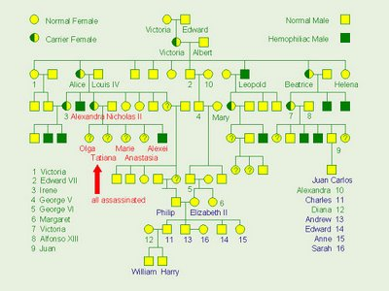
II. MUTATIONS: LOCATIONS/CAUSES
A. Germinal (in tissue that gives rise to sperm or eggs)
1. Can be passed on to offspring
e.g.: Queen Victoria & haemophilia

Slide 109
B. Somatic Mutation (in body tissues)
1. Not inheritable
2. Responsible for many cancers
C. Replication errors
1. Pretty rare; enzyme (DNA polymerase) that carries out replication also “proofreads” and makes corrections; only about 1 per 109 base pairs replicated!
D. MUTAGENS (def’n): environmental substances that cause mutations
1. Radiation: X-rays, UV rays, exposure to
radioactive elements
2. Chemicals: generally organic chemicals;
pesticides, cigarette smoke, etc.

Slide 110

III. How Mutations cause Genetic Disorders
A. Normally, chemical reactions occur in "pathways"…
B. If Enzyme BC is mutated (nonfunctional) then
compounds C and D would not be made,
and clot doesn’t form -- Haemophilia

Slide 111
Working Example, cont’d
Given the following DNA nucleotide sequence:
TGTCAACGTACTG
For each mutation below:
a) work out the NEW amino acid sequence
b) identify the type of mutation
c) predict the consequences for protein function

Slide 112
1. a G is inserted in between the double As
TGTCAACGTACTG
TGTCAGACGTACTG
mRNA:
ACAGUUGCAUGAC
Separate into codons
ACA GUU GCA UGA C
3. Find A.A.s to match code
Thr – Val – Ala- Stop
mRNA:
ACAGUCUGCAUGAC
2. Separate into codons
ACA GUC UGC AUG AU
3. Find A.A.s to match code
Thr – Val- Cys- Met…..
This is a frame shift mutation that results in the protein not terminating. The result is likely a non functional protein.

Slide 113
The second T from the left is deleted
TGTCAACGTACTG
TGCAACGTACTG
mRNA:
ACAGUUGCAUGAC
Separate into codons
ACA GUU GCA UGA C
3. Find A.A.s to match code
Thr – Val – Ala- Stop
mRNA:
ACGUUGCAUGAC
Separate into codons
ACG UUG CAU GAC
3. Find A.A.s to match code
Thr –Leu – His- Asp
This is a deletion mutation that results in the protein not terminating. The result is likely a non functional protein.

Slide 114
The third T from the left is changed to a C
TGTCAACGTACTG
TGTCAACGCACTG
mRNA:
ACAGUUGCAUGAC
Separate into codons
ACA GUU GCA UGA C
3. Find A.A.s to match code
Thr – Val – Ala- Stop
mRNA:
ACAGUUGCGUGAC
Separate into codons
ACA GUU GCG UGA C
3. Find A.A.s to match code
Thr – Val – Ala- Stop
This is a silent missense mutation that results in the protein terminating as originally because although the DNA sequence changed, the amino acids encoded remained identical.

Slide 115
Protein Synthesis Quiz
Stated Clearly Video
Ethics Lesson
Show these videos:
Questioning Bioengineering
You are NOT your genes
ELSI Ethics
Poll Everywhere Activity

