Slide 1
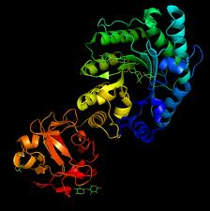
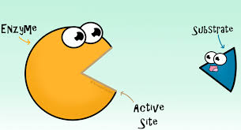
Enzymes
Notes:
http://ed.ted.com/lessons/activation-energy-kickstarting-chemical-reactions-vance-kite

Slide 2
Enzymes: Important Terminology
Metabolism: Ted-ed Speeding up Rxn’s
In order for cells to maintain homeostasis, they must constantly convert chemicals from one form to another, in order to produce necessary molecules, obtain usable molecules from food, and produce energy rich molecules
These constantly occurring chemical reactions are collectively known as metabolism
Notes:
http://ed.ted.com/lessons/how-to-speed-up-chemical-reactions-and-get-a-date#watch

Slide 3
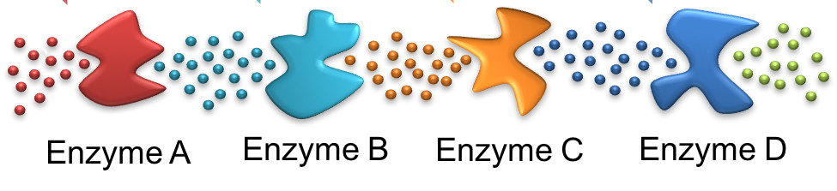
Metabolism a term to collectively describe all the chemical reactions occurring constantly in the cell that maintain homeostasis in a cell or organism
Metabolic pathways are the orderly step-wise series of chemical reactions from the initial reactants to the final products
One reaction leads to the next; highly structured reaction

Slide 4
Ex. Photosynthesis, cellular respiration
It is controlled by enzymes
  Each step (ex. Each chemical reaction) within the metabolic pathway requires a specific enzyme
 | Step 1 |  | Step 2 |  | Step 3 |  | Step 4 |  | Step 5 |  | Step 6
A |  | B |  | C |  | D |  | E |  | F |  | G
Reactant | Enz. 1 |  | Enz. 2 |  | Enz. 3 |  | Enz. 4 |  | Enz. 5 |  | Enz. 6 | Product

Slide 5
There are reasons why metabolic pathways exist:
  It is not possible in biological systems to have a single reaction that could produce complex molecules from simple reactants
  ex. 6CO₂ + 6H₂O → C₆H₁₂O₆ + 6O₂
  would never happen in a cell in one step (photosynthesis requires many intermediate steps)

Slide 6
One pathway can lead to several others
  Intermediate products of one pathway can be starting reactants for another pathway
  Ex. A → B C
  D
Having more than one step means that there are more places where the overall reaction can be controlled
 |  |  |  | β |  | Y | → | Z | → | AA | → | BB
 |  |  |  | ↑ |  | ↑
 |  |  |  | α |  | X
 |  |  |  | ↑ |  | ↑
 |  | A | → | B | → | C | → | D | → | E
 |  | ↓ |  |  |  |  |  | ↓ |  | ↓
 |  | L | ← | ϕ | ← | δ | ← | H |  | Q
 |  | ↓ |  |  |  |  |  | ↓ |  | ↓
 |  | M |  |  |  |  |  | I |  | R | → | X
 |  | ↓ |  |  |  |  |  | ↓ |  | ↑
O | ← | N | → | P | ← | K | ← | J | → | S

Slide 7
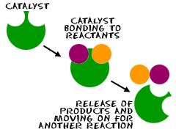
II. Enzyme = Biological Catalysts
A protein that can speed up a chemical reaction without being consumed that speeds up a chemical reaction
Enzymes are the sites of chemical reactions, but aren’t used up in the reaction or permanently changed by the reaction
Ex. They can hold reactant molecules together long enough for them to react

Slide 8
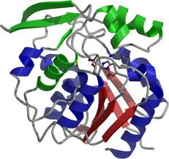
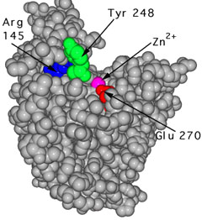
Enzymes are highly specific (each enzyme speeds up only one reaction)
Specificity arises from the protein’s complex three-dimensional structure
No cellular reaction will occur without its specific enzyme to act as catalyst
Enzymes have a groove/dimple into which only specific reactant molecules may enter called the ACTIVE SITE

Slide 9
Enzyme names usually end with the suffix “ase” or sometimes “sin”
Named after the substrate on which the enzyme works on
  Ex. RNA polymerase – constructs RNA
  Ex. Lactase – breaks down lactose
  Ex. Trypsin – breaks down proteins
  Ex. Pepsin – beaks down proteins

Slide 10
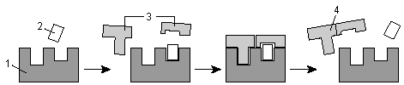
Substrate is the reactant in an enzyme’s reaction
The equation for an enzyme-catalyzed reaction is always:
Enzyme + Substrate → Enzyme Substrate Complex → Enzyme + Product

Slide 11
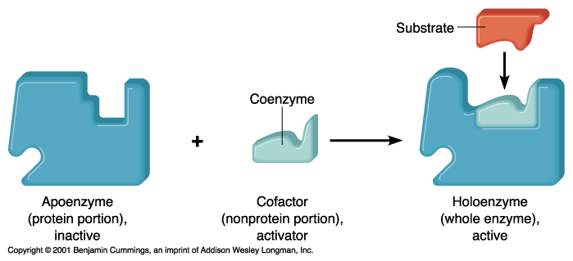
III. What are Enzymes Made of?
A protein part called an APOENZYME that gives it its specificity
A cofactor which is a non-protein molecule or ion needed for proper enzyme function (“helpers”)

Slide 12
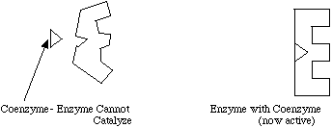
Coenzymes are organic cofactors
  Bind to the enzyme and usually participate directly in the reaction
  Are essential because they are part of a coenzyme’s structure

Slide 13
Serve as carriers for groups of electrons
  May participate in reaction by accepting or giving atoms to the reaction
  Ex. NAD (nicotinamide adenine dinucleotide) is a coenzyme of many oxidation-reduction reactions
Interaction with the substrate molecule
  Ex. Weaken bonds to the substrate

Slide 14
Many water-soluble vitamins help make up parts of coenzymes
  Ex. Niacin (nicotinic acid) makes up part of coenzyme NAD⁺
  Ex. Riboflavin (Vitamin B2) makes up part of coenzyme FAD

Slide 15
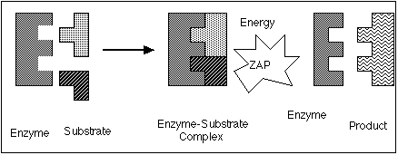
Models: Enzyme Function
Lock and Key model (Animation)
The enzymes and substance fit perfectly together
Only specific substrate(s) will fit into the active site, and enzymes will only act on their substrate
Notes:
http://www.sumanasinc.com/webcontent/animations/content/enzymes/enzymes.html

Slide 16
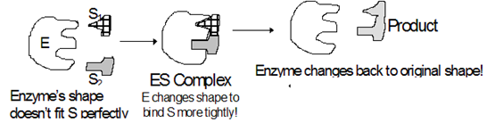
The Induced-Fit model
Induced Fit model is a refinement of the lock and key model
The act of binding the substrate(s) induces slight changes in shape that accommodates the substrate more perfectly and facilitates the chemical reaction about to take place

Slide 17
Upon binding, the enzyme undergoes a slight conformational change to more perfectly bind the substrates
Then the reaction takes place, the enzyme-substrate complex separates, and the enzyme reassumes its original shape

Slide 18
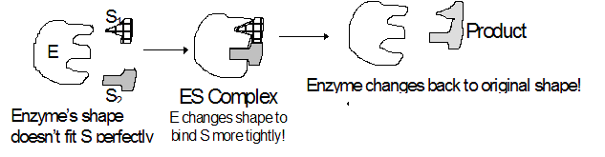
Lock and Key model vs. Induced Fit model
Ex. Lock and Key
Ex. Induced Fit

Slide 19
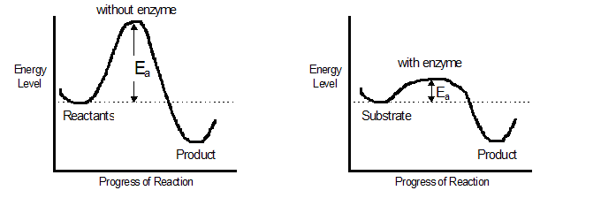
III. How does an Enzyme work?
Enzymes lower the ACTIVATION ENERGY required for the reaction to proceed (Ted-ed)
Notes:
http://ed.ted.com/lessons/activation-energy-kickstarting-chemical-reactions-vance-kite
- Same video as the first slide?

Slide 20
Activation Energy is defined as the energy that must be supplied to cause molecules to react with one another
Enzymes do this by bringing the substrate molecules together and holding them long enough for the reaction to take place
Ex. Reactions that occur at 100°C can occur at 37°C with the use of an enzyme

Slide 21
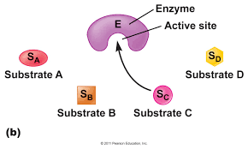
Factors Affecting Enzyme Activity
Enzymes are Proteins
  Enzymes are affected by the same things that effect proteins
  Since the shape of enzymes determines the shape of the active site, which determines their function, anything that changes the shape of an enzyme will effect the enzymatic yield.

Slide 22
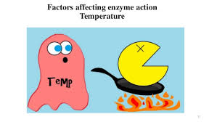
Some factors are:
  pH
  Temperature
  Concentration of substrates
  Concentration of enzyme
  Presence of inhibitors

Slide 23
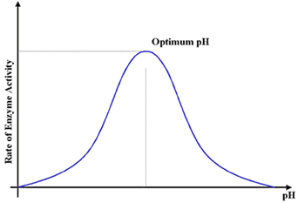
II. pH
Enzyme shape is dependent upon pH-sensitive interactions between R-groups

Slide 24
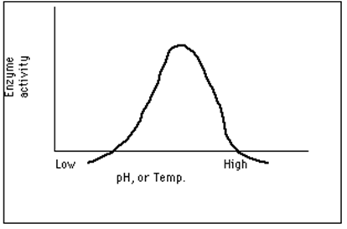
Any change in pH denatures the enzyme by causing it to change shape:
  A denatured protein is one that has lost its normal configuration, and therefore its ability to form an enzyme-substrate complex
  Most enzymes prefer pH’s of 6-8
  Some exceptions:
    Pepsin in the stomach – pH ~2
    Trypsin in the small intestine – pH ~8

Slide 25
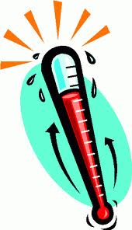
III. Temperature
Temperature is a measure of the average kinetic energy in a container of molecules
As the temperature rises, the reaction rates increases

Slide 26
Increasing the temperature slightly will, at first, increase the rate of reaction and product formation because it speeds up the rate at which substrates bump into enzymes
37°C is optimum for human enzymes

Slide 27
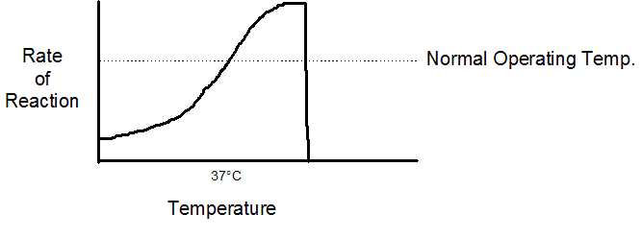
Temperature too high (above about 40°C) will denature the enzyme (Animation)
  Slight denature causes the enzyme reaction to slow
  Huge denature causes the enzyme reaction to stop
Notes:
http://www.sumanasinc.com/webcontent/animations/content/proteinstructure.html

Slide 28
As the temperature drops, the reaction rate decreases because there are fewer enzyme-substrate collisions
Very low temperatures do not normally denature the enzyme

Slide 29
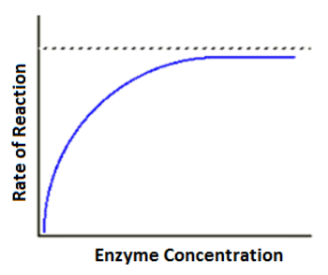
IV. Concentration of Substrates
If the concentration of substrates increases, the amount of product increases
However, after a certain concentration, the rate will not increase anymore, as all the enzymes are “saturated” with substrates and cannot work any faster

Slide 30
If the concentration of substrate decreases, the rate of product formation will generally decrease as well

Slide 31
V. Concentration of Enzyme
This is what limits the overall rate of reaction. Providing there is adequate substrate (and there is typically millions more substrate molecules than enzyme molecules), the more enzyme you add, the more product you get

Slide 32
The less enzyme you have, the less product you get. In other words, if [enzyme] increases, rate of product formation increases. If the amount of enzyme decreases, the rate of product formation decreases. The rate will only level off if you run out of substrate, which is usually not the case.

Slide 33

VI. Presence of Inhibitors
Inhibitors are molecules that bind to the enzyme in some way to prevent or reduce the rate of substrate binding to enzyme

Slide 34
There are several ways in which inhibition can work:
  Competitive Inhibition:
  A molecule that looks like the substrate can compete for space at the active site (the place where the substrate binds to enzyme). This will slow down the reaction rate. The inhibitor binding to the enzyme can be reversible or irreversible.

Slide 35
Obviously, the more inhibitors are added, the lower the rate of reaction, and the less product is going to be made.

Slide 36
  Non-competitive Inhibition
  In this case, the inhibitor binds to another place on enzyme (not the active site). The inhibitor may look completely different from the substrate

Slide 37
When the inhibitor binds, it causes the enzyme to change shape at the active site so substrate cannot bind. Binding may, as it is for competitive inhibition, be reversible or non- reversible. This type of inhibition is also known as “allosteric” inhibition.

Slide 38
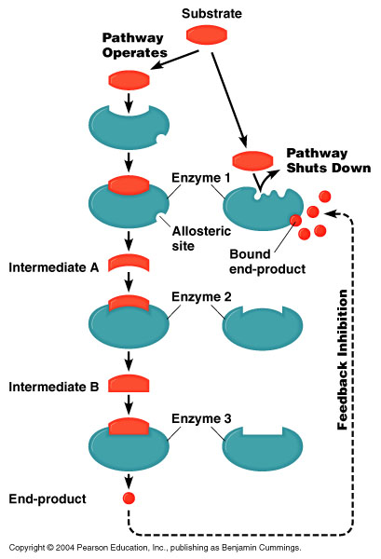
Feedback Inhibition
  When an excess of product competitively binds with enzyme active sites, getting in the way of substrate molecules and slowing enzyme activity. This is called feedback inhibition.
  In a multi-enzyme pathway, often the end product binds at a special site on the first enzyme to shut down the whole pathway if the product builds up. This is non-competitive inhibition or allosteric control
  Animation
Notes:
http://highered.mcgraw-hill.com/sites/0072943696/student_view0/chapter2/animation__feedback_inhibition_of_biochemical_pathways.html

Slide 39
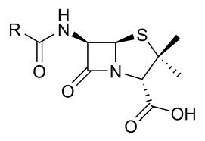
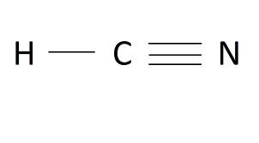
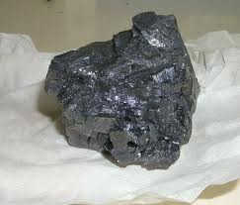
Inhibitors can also be chemicals introduced into a system from the outside, and can act as medicines or poisons.
  Penicillin is a medicine that kills bacteria. It works by binding irreversibly to the enzyme that makes bacterial cell walls.
  HCN (hydrogen cyanide) is a lethal irreversible inhibitor of enzyme action in humans.
  Lead (Pb⁺⁺) and other heavy metals (like mercury (Hg⁺⁺) and cadmium) are non-competitive inhibitors that cause poisoning when they bind irreversibly to enzymes and make them denature

Slide 40
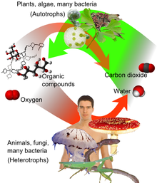
Cellular Respiration
Both plants and animals respire
Cells obtain their energy from the breakdown of carbohydrates, proteins and lipids
These molecules are converted to glucose which is then broken down into CO₂ and H₂O
C₆H₁₂O₆ + 6O₂ → 6CO₂ + 6H₂O

Slide 41
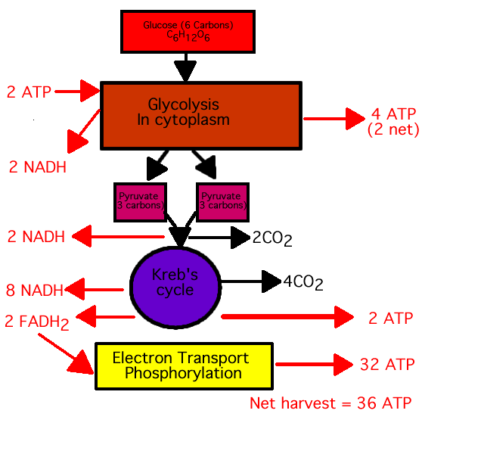
Process of respiration is not as simple as indicated by the above reaction (animation)
It requires 4 subpathways before CO₂ and H₂O are given off
Notes:
http://www.sumanasinc.com/webcontent/animations/content/cellularrespiration.html

Slide 42
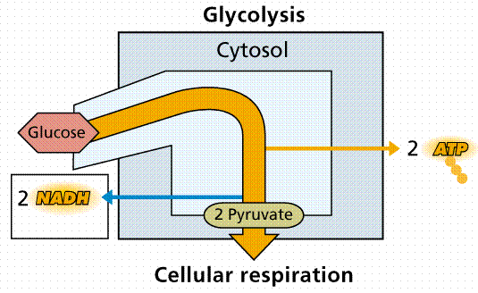
These subpathways are:
Glycolysis
  the breakdown of glucose (6C) into 2 pyruvic acid molecules (2 – 3C)
  occurs in the cytoplasm
  end of the glycolysis process yields:
    2 pyruvic acid (3C) molecules
    4 ATP (a net of 2 ATP because 2 ATP was used to start the reaction)
    2 NADH per glucose
  Animation
Notes:
http://www.sumanasinc.com/webcontent/animations/content/cellularrespiration.html

Slide 43
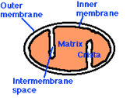
Transition Reaction
  Pyruvic acid (3C) is changed to active acetate (2C) (same as acetyl CoA)
  Loss of 1C per molecule of pyruvic acid
  Occurs in mitochondrion
  End of the transition reaction yields:
    2C segment being passed to the Krebs
    1 NADH molecule per pyruvic acid
    1 CO₂

Slide 44
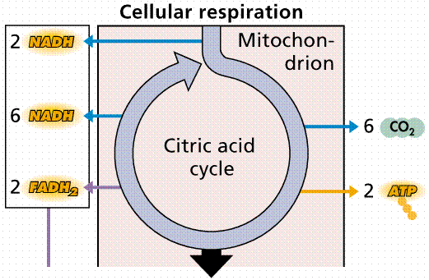
Krebs cycle (Animation)
  Oxidative decarboxylation takes place (H’s and C’s removed)
  Cyclic; occurs over and over
  The end of Kreb Cycle yields:
    1 Oxaloacetic Acid molecule (4C)
    1 ATP
    3 NADH
    1 FADH₃
    2 CO₂

Slide 45
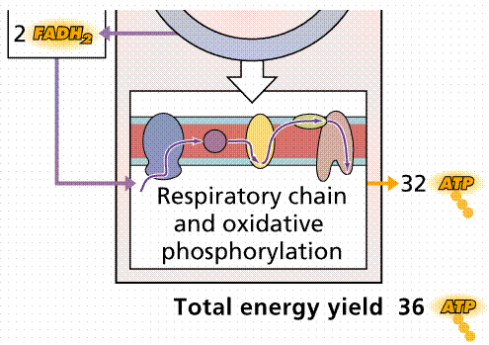
Respiratory chain (animation)
  H’s (attached to NAD and FAD) are attached to O’s to form H₂O
  end of Electron Transport
  Phosphorylation yields:
    3 ATP per NADH
    2 ATP per FADH₂
    2 water molecules per NADH or FADH₂
Notes:
http://www.sumanasinc.com/webcontent/animations/content/cellularrespiration.html

Slide 46
Summary
* Energy produced from ONE glucose molecule
NADH
Subpathway | Per molecule | Total
Glycolysis | 1 NADH/ Glyceraldehyde 3- Phosphate | 2 NADH
Transition Reaction | 1 NADH/ pyruvic acid | 2 NADH
Kreb Cycle | 3 NADH/ pyruvic acid | 6 NADH
Total |  | 10 NADH

Slide 47
FADH
ATP
Subpathway | Per molecule | Total
Kreb Cycle | 1 FADH₂/ pyruvic acid | 2 FADH₂
Total |  | 2 FADH₂
Subpathway | Per molecule | Total
Glycolysis | 2 ATP/ Glyceraldehyde 3- Phosphate | net of 2 ATP *used 2 ATP to start the reaction
Kreb Cycle | 1 ATP/cycle | 2 ATP
Electron Transport | 3 ATP/NADH | 30 ATP
Electron Transport | 2 ATP/FADH | 4 ATP
Total |  | 38 ATP

Slide 48
Other types of Metabolism
Carbohydrates (ex. Glucose) are not the only products that can supply energy to the cell for storage as ATP
Proteins and lipids can also be broken down and supply energy to the cell
Fats are much better supplier of energy than is glucose but glucose is the preferred energy source

Slide 49
Aerobic vs. Anerobic Respiration
When oxygen is present (aerobic conditions), most organisms will undergo the Kreb’s cycle and Electron Transport Phosphorylation to produce ATP
In eukaryotes, these processes occur in the mitochondria, while in prokaryotes they occur in the cytoplasm

Slide 50
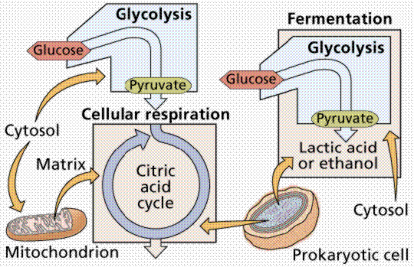

Slide 51
Under anaerobic conditions, the absence of oxygen, pyruvic acid can be routed by the organism into one of three pathways
  Lactic acid fermentation
  Alcohol fermentation
  Cellular (anaerobic) respiration

Slide 52
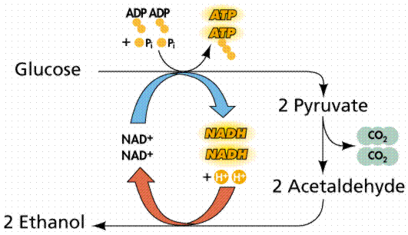
Human cannot ferment alcohol in their own bodies, we lack the genetic information to do so.
However, this is possible in something like yeast or anaerobic bacteria:
These biochemical pathways, with their myriad reactions catalyzed by reaction-specific enzyme all under genetic control, are extremely complex

Slide 53
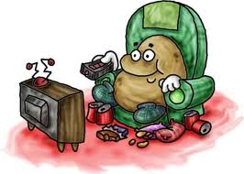
Alcohol fermentation is the formation of alcohol from sugar
Many organisms will also ferment pyruvic acid into other chemicals, such as lactic acid
Ex. Humans ferment lactic acid in muscles where oxygen becomes depleted, resulting in localized anaerobic conditions
This lactic acid causes the muscle stiffness couch-potatoes feel after beginning exercise programs

Slide 54
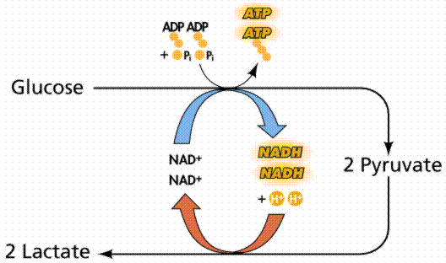
The stiffness goes away after a few days since the cessation of strenuous activity allows aerobic conditions to return to the muscle, and the lactic acid can be converted into ATP via the normal aerobic respiration pathways

Slide 55
I. Thyroxin: the Basics
A hormone produced in the thyroid gland (neck) that controls the metabolic rate (rate of the chem. Reactions in the cell) in ALL the cells in your body
(Thyroid Animation)
The more thyroxin present, the greater the metabolic rate
This will increase sugar and oxygen consumption and also create more body heat
Notes:
http://ed.ted.com/lessons/how-does-the-thyroid-manage-your-metabolism-emma-bryce

