Slide 1
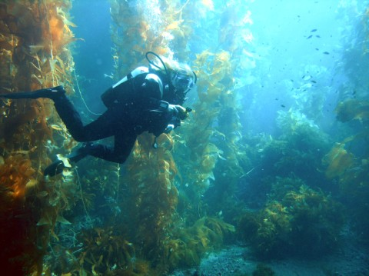
Simple Plants: Chapters 20 and 21 20-1 Characteristics of Algae

Slide 2
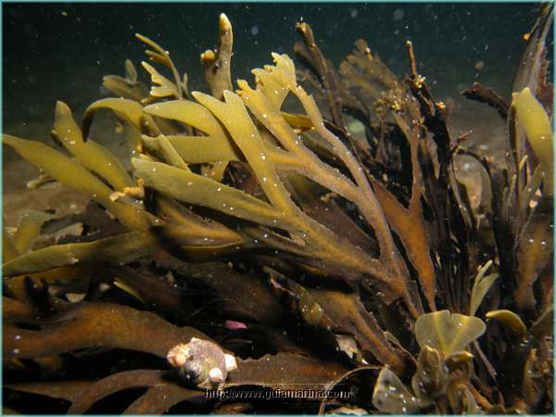
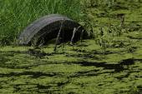
I. Introduction
A. Description:
1. Are photosynthetic organisms
2. Live in fresh water (e.g. streams, ponds, lakes, or swamps) and oceans

Slide 3
Must live in or near a source of water
1. Reason: lack internal system of tubes to
move materials from one part to another
2. Water they live in:
a) Provides: CO₂, O₂, and nutrients and carries away wastes

Slide 4
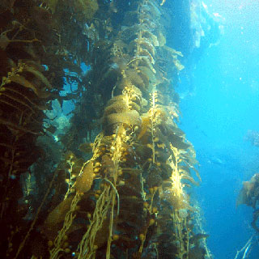
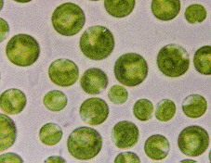
C. Types of algae
Most are multicellular; Giant kelp can grow to 60 m
2. Unicellular are microscopic (also classed as protists)
Chlorella sp..

Slide 5
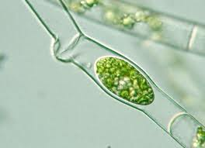
Algae structures
Cells have cell walls
2. Never have roots, stems, or leaves like land plants

Slide 6
II. Adaptations of Algae to Life Under Water
How they differ from land plants:
Because they: | This means Algae:
Don’t need protection from drying out | Are thin (only 2 cells thick!)
Exchange materials directly with surrounding water | Have no vascular tissues
Are supported by water | Don’t need stems to keep from falling over
Reproduce in water | Make gametes that swim

Slide 7
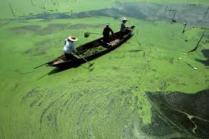
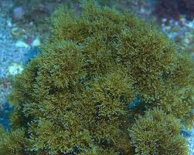
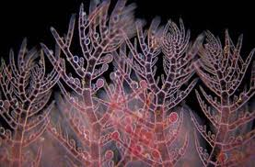
II. Chlorophyll and Accessory Pigments
A. Challenges of underwater life:
Water absorbs much of the energy of sunlight
Algae groups have evolved different forms of chlorophyll that absorb different wavelengths of light
3. Some also evolved other light-absorbing compounds called accessory pigments
a) They can live in deeper water
b) Different reflected wavelengths give algae a wide range of colours

Slide 8
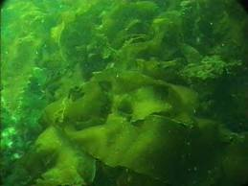
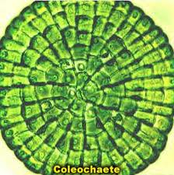
20-2 Groups of Algae
I. Chlorophyta – The Green Algae
A. Habitat:
1. Found mostly on moist land and in fresh water

Slide 9
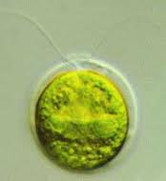
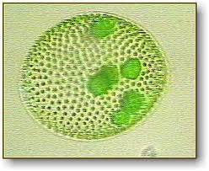
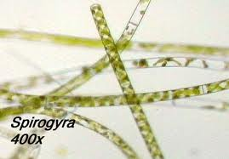
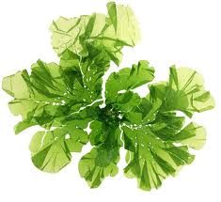
Cell arrangement: | Name: | Sketch:
Single-celled | Chlamydomonas
Colonial | Volvox
Filamentous (threadlike) | Spirogyra & Oedegonium
Multicellular | Ulva “sea lettuce”

Slide 10
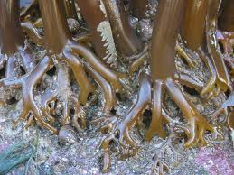
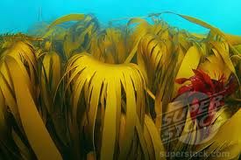
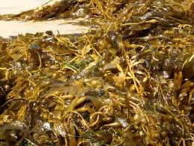
II. Phaeophyta – The Brown Algae
Habitat:
1. Marine: especially cool, shallow waters in temperate or arctic oceans

Slide 11
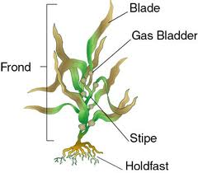
B. Most “sea weeds” are: species of brown algae
1. Giant kelp
2. Fucus (common name: Rockweed):
a) Make a labeled sketch:
b) Give function of:
i) Holdfast: attach plant to ocean bottom
ii) Bladders: keep plant floating upright in water

Slide 12
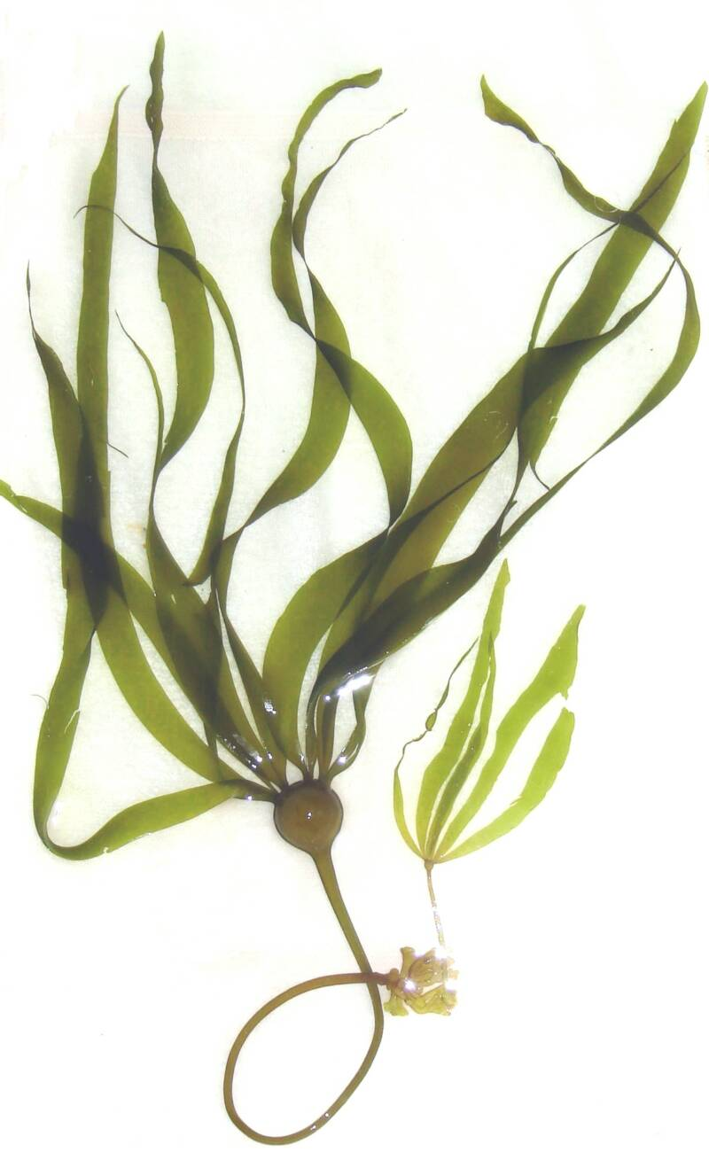
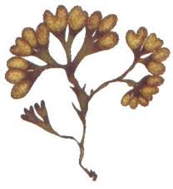

Slide 13
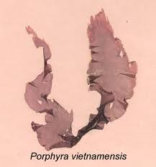
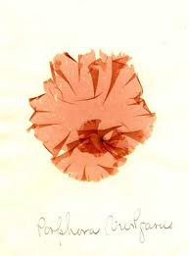
III. Rhodophyta – The Red Algae
Habitat:
1. Marine: from arctic to tropics, from surface to 170 m deep due to accessory pigments
B. Example:
1. Porphyra (dried, it’s called nori and used to make sushi)

Slide 14
20-3 Algae Lifecycle
Include diploid (2n) and haploid (n) generations
Switching back and forth is known as Alternation of Generations!
This is characteristic of the plant kingdom
Algae also shift between sexual (gametes) and asexual (zoospores) reproduction

Slide 15
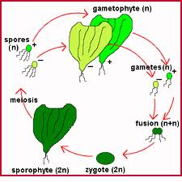
Reproduction in Ulva (Sea Lettuce)
Diploid and haploid stages are multicellular
Diploid plant is called the sporophyte
Haploid plant is the gametophyte
When two gametes fuse, the diploid sporophyte forms
The sporophyte undergoes meiosis and releases haploid zoospores (+ and -) which in turn form the gametophytes.
The gametophytes release gametes (+ and -)which fuse to form sporophytes

Slide 16
Reproduction in Fucus
Alternation of generations, but multicellular gametophyte is missing
Diploid sporophyte is present with specialized reproductive areas on the tips
One area produces female gamete – egg
One area produces the male gamete – motile sperm
Fertilization occurs, the zygote sinks, attaches to a rock and forms the diploid sporophyte.

Slide 17
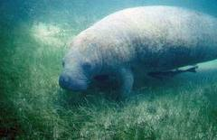
20-4 Where Algae Fit into the World
Ecological role:
1. In food chains: called the “grasses of the seas”
Oh, I love manatees

Slide 18
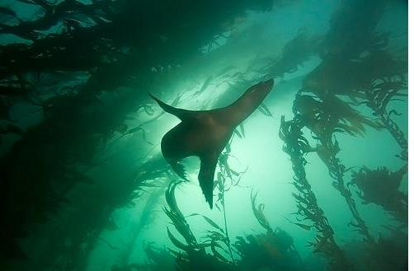
Habitat for others:
e.g. the kelp forests of
North American coasts
3. Oxygen providers:
a) Life could not have evolved without the O₂ they release in photosynthesis
b) Algae do 50 – 70% of all photosynthesis on Earth

Slide 19
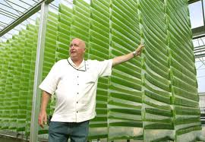
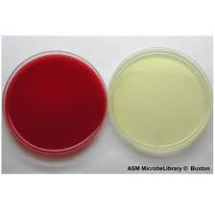
B. Uses by humans
1. Sources of chemicals used in:
a) Drugs
b) Food additives
c) Industrial products
d) Agar used to make plates for
microbiology
Biofuel algae
Carageenan Containing Products

Slide 20
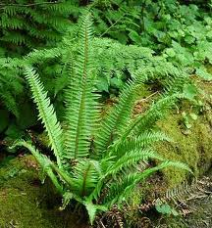
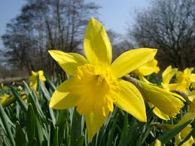
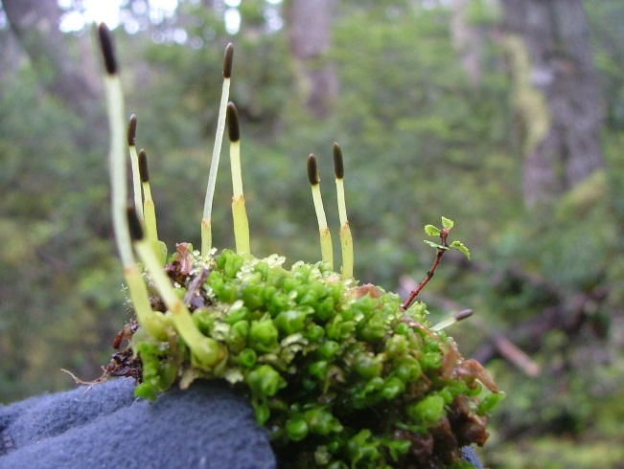
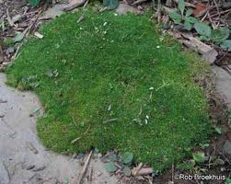
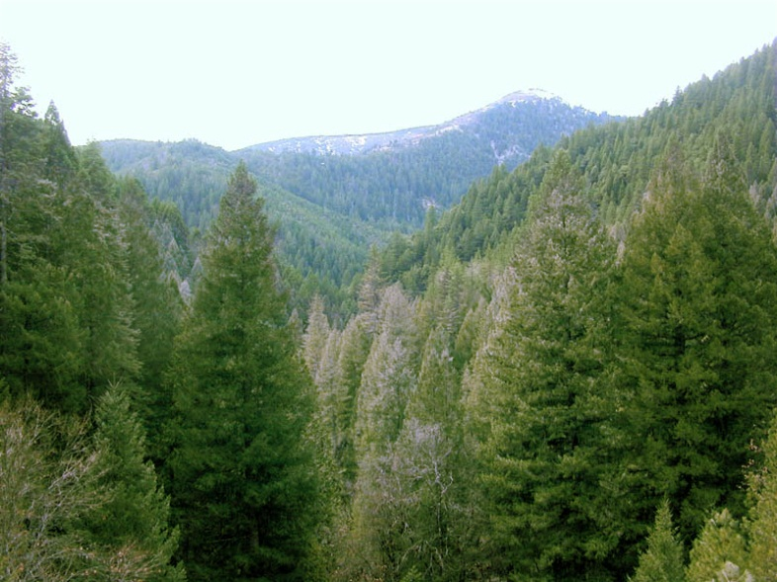
21-1 Plants Invade the Land

Slide 21
The Demands: | What land plants must do:
Provide cells with a constant water supply | a) find water b) Deliver it to all cells c) Protect against water loss by evaporation
Expose food-making parts to sunlight | need rigid supports to hold up & expose leaves
Different tasks performed in distant plant parts: a) roots take up water & nutrients b) leaves make food | Need a transport system: a) water/nutrients upward b) sugars made by photo- synthesis downward
For reproduction, gametes must find each other | Need a mechanism to deliver sperm that DOESN’T involve having them swim

Slide 22
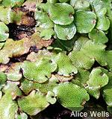
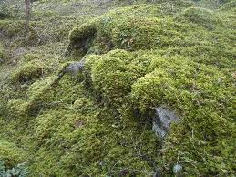
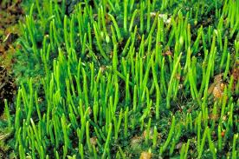
21-2 The Mosses, Liverworts, and Hornworts
Introduction
A. Need water for reproduction to occur
B. Thrive only in wet areas: swamps, marches, near streams, in rainforests
C. All less than a few cm tall

Slide 23
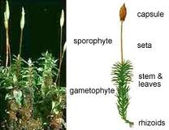
D. Mosses:
1. Each plant has:
a) A thin, upright shoot like a stem with tiny Leaves called the Gametophyte
b) From base of the shoot grow rhizoids that anchor the plant
c) Shoots may be topped with a brown flag-like structure called a Sporophyte

Slide 24
2. Copy and label the diagram in 21-5:

Slide 25
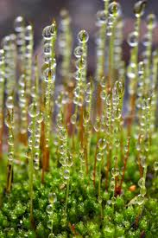
II. Physical Characteristics of Bryophytes
Water Conduction
1. Lack tubes
2. Water passes between cells by osmosis and surface tension
3. These methods work: over short distances only - can’t grow tall
4. Lack a protective surface covering to prevent evaporation
5. “Leaves” only one cell thick; dry out quickly
6. Lack true roots: rhizoids anchor, but don’t absorb and transport water & minerals

Slide 26
B. Reproduction
1. Sperm must swim to the egg, using flagella to propel themselves
2. Moss environment must be wet for: at least part of the year

Slide 27
The Moss Life Cycle – Alteration of Generation
But before we get into the notes, let’s look at a summary animation first!

Slide 28
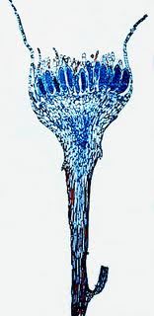
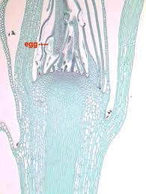
II. Alternation of Generations in Mosses
Life Cycle Stages:
1. At the tips of the gametophyte:
a) Antheridium: makes sperm
b) Archegonium: makes eggs

Slide 29
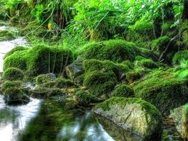
Fertilization
a) Sperm swims to archegonium
b) Plants must be covered with rainwater or dew
c) Gamete fusion produces a zygote (diploid:“2n”)

Slide 30
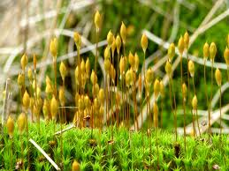
3. Growth of 2n Generation
a) Zygote grows into sporophyte
b) Its water and nutrients are supplied by female gametophyte
c) Sporophytes cannot live independently
Capsule at end of stalk makes haploid (1n) spores by meiosis

Slide 31
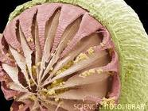
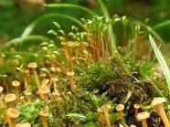
4. Spore Release
a) When ripe, capsule opens, shakes out spores
b) Spores carried off by wind and water

Slide 32
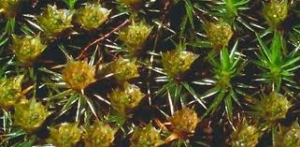
5. Growth of 1n Generation
a) Spores that land in moist places germinate
into a protonema
b) Protonema = mass of tangled green filaments
(look like algae!)
c) This grows rhizoids into soil and shoots into
the air that develop into moss gametophytes
d) The cycle begins again!

Slide 33
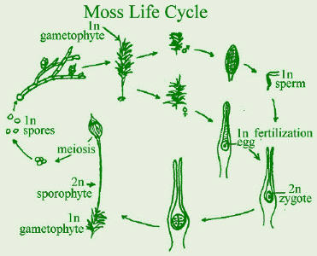
B. Summary:
Gametophyte (1n) is the dominant, obvious stage
2) Fertilization requires standing water
Sporophyte is dependent upon gametophyte

Slide 34
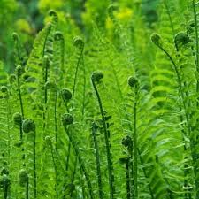
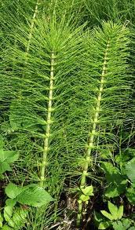
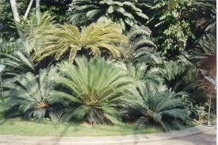
21-3 The Ferns and the First Vascular Plants
I. Introduction to Tracheophyta
A. “True” Land Plants because they: have evolved ways of freeing themselves from dependence upon wet environments

Slide 35
How did they do it?
1. Vascular tissues: 2 types:
a) Xylem: moves water from roots to rest of plant
b) Phloem: transports nutrients & photosynthetic products
Tracheid cells in xylem have thick, strong walls that help plants stand up against gravity
3. True roots have transport tissue in a central vascular cylinder
4. True leaves have:
a) veins (def’n): bundles of vascular tissue
b) cuticle (def’n): waxy covering that prevents water loss

Slide 36
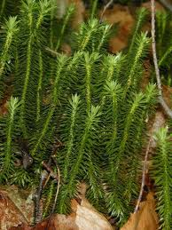
II. Club Mosses and Horsetails
The only living descendants of large, ancient
land plant groups
B. Some grew up to 40 m tall!
C. Some fossilized into huge coal beds

Slide 37
Sketch a horsetail: Label its stem and leaves:

Slide 38
III. Physical Characteristics of Ferns
A. Organs:
Have true vascular tissues
True roots
Underground stems called rhizomes
4. Large leaves called fronds

Slide 39
B. Size & Habitat
1. Up to 1 metre tall in North America; in tropical forests can be the size of small trees
2. Found in wet, or seasonally wet places (e.g. rainforests of Pacific Northwest)

Slide 40
IV. Alternation of Generations in Ferns
A. Life Cycle Stages:
1. Spore Production/Release:
a) Adult sporophytes produce haploid spores on underside of fronds
b) Formed in tiny containers called sporangia
c) Sporangia cluster together in groups called sori
d) When ripe, spores released; carried by wind, water
Notes:
https://tals.une.edu.au/files/2010/09/plant_lifecycles/ferns_animation.htm

Slide 41
2. Growth
Spores develop into haploid (1n) gametophytes
Grow into small, heart-shaped prothallium
c) Antheridia and archegonia develop on underside of prothallium

Slide 42
3. Fertilization
Antheridia release sperm
b) Sperm must swim through a film of water to
an archegonium
Each archegonium contains one egg
d) Fusion of gametes produces a diploid (2n)
sporophyte

Slide 43
4. Growth
New sporophyte puts out fronds, rhizomes
Gametophyte withers away

Slide 44
B. Summary:
1. Dominant, obvious stage is the sporophyte
2. Sporophyte is a well-developed land plant with
true vascular tissue
3. Gametophyte can only grow in moist areas
4. Sex still requires water

Slide 45
21-4 Where Mosses and Ferns Fit into the World
I. Mosses: Ecological Role
A. Common in damp areas

Slide 46
II. Mosses: Uses by Humans
A. Gardening
1. Used as plants
2. Peat moss added to soil to improve it
B. Burning sphagnum
1. Flavours scotch whiskey
2. Peat is used as fuel

Slide 47
III. Ferns: Ecological Role
A. Common in the shadows of forest trees, because
they: require little light
IV. Ferns: Uses by Humans
A. Gardening
1. Used as plants
B. Food
1. Some species eaten when young;
fronds called fiddleheads

