Slide 1
The Scientific Method

Slide 2
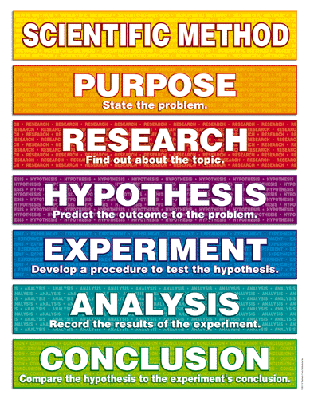

Slide 3
What is the purpose of this experiment?
What do we want to figure out?

Slide 4
What other experiments have taken place?
Are there any limitations or other possibilities to what you want to discover?

Slide 5
What specifically are you experimenting about?
If… then… because…
Example: If I add fertilizer to the garden, then the plants will grow taller because the plants will be getting more nutrients.

Slide 6
What are the steps that must be taken for this experiment?
Consists of an extremely detailed list of materials necessary as well as a detailed list of steps for the procedure

Slide 7
What results occurred from your experiment?
Must have results from the original conditions.
Compare to results from when the change was made.

Slide 8
What did you discover?
Was your hypothesis supported or not supported?
What factors may have affected your result?
If you were to redo the experiment, what changes would you make?

Slide 9
Controlled experiment
Testing a hypothesis where only one factor is changed…
Controlled variable…
All the constants (stay the same) throughout the experiment

Slide 10
Dependent vs Independent Variables
Independent Variable
Dependent Variable
The one variable you change
What causes the result…
The variable that is being measured
The result you are trying to see…
Depends on the independent

Slide 11
Scenario
You have two fish – one goldfish and one angelfish fighting fish. You give them the same amount of food each day at the same time. One of the fish is in fresh water and the other is in salt water. The objective of the experiment is to find out which type of fish consumes more food.
Is this experiment controlled? Why or why not?
How would you redesign this experiment to make it controlled? (look at the objective)
Identify the control, independent and dependent variables in the redesigned experiment
Notes:
No, fish different and environment different
Fish have to be in the same environment
Control: amount of food given, time, same environment,
Independent: Type of fish
Dependent: amount of food eaten

