Slide 1
The Circulatory System
Anatomy & Physiology 12

Slide 2
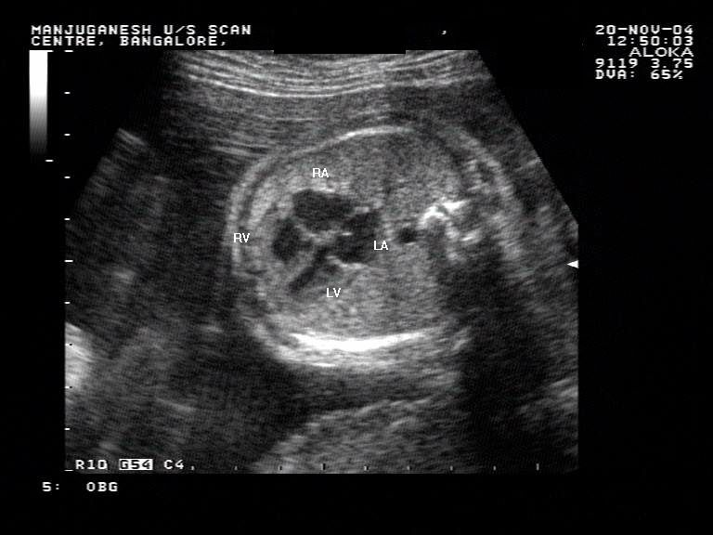
Adult & Fetal Circulation
Fetal Heart
Heart develops in 3rd and 4th week in uterus
At end of 8 weeks, the embryo’s organ systems, including heart are functioning
During fourth month, fetal heartbeat is loud enough to be heard with stethoscope
Image: Ultrasound showing 4 chamber heart
Video: 12 week ultrasound – you can see beating heart
Notes:
http://www.youtube.com/watch?v=hH7FspvTI9I

Slide 3
II. Difference between Adult & fetal circulation
Differences
Fetal lungs are not used to provide oxygen since it cannot breathe air inside the womb because it’s immersed in amniotic fluid
Fetus must get all its nutrients from mom, as well as let her take care of its wastes

Slide 4
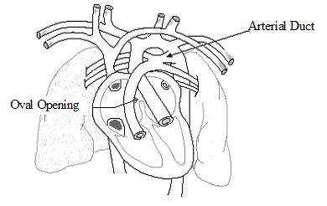
4 features unique to the fetus
Oval Opening (foramen ovale)
Opening between the right and left atria, covered by a flap that acts like a valve
Some of the blood from the right atrium is therefore pumped through this flap and into the left atrium, bypassing the pulmonary circuit
If the oval opening doesn’t close after birth, it can cause mixing of blood and “blue babies”. Corrected with open heart surgery.

Slide 5
Arterial Duct (ductus arteriosus)
Connects pulmonary artery and aorta
Much if the blood being pumped out of the heart to the lungs will be directed away from the lungs and into the aorta
Like the oval opening, the arterial duct’s function is to bypass the pulmonary circuit.

Slide 6
Umbilical Arteries & Veins
Vessels hat travel to and from placenta
Placenta is a membrane shared by the mother and baby across which gases, nutrients, and wastes are exchanged
Artery travels toward placenta with waste
The umbilical arteries are grafted to the iliac arteries
Vein travels from placenta to fetus with blood rich in O₂ and nutrients

Slide 7
Venous Duct (ductus venosus)
Connects umbilical vein to the vena cava to bring the blood back to he baby’s heart
It attaches right at the babies liver, but bypasses most of the liver
This is why chemicals ingested by the mother can seriously affect the baby
Fetal Circulation Animation
Notes:
http://www.indiana.edu/~anat550/cvanim/fetcirc/fetcirc.html

Slide 8
III. The Path of the blood through the fetus
Begin with blood collecting in right atrium
From there, blood can go into left atrium through oval opening plus into right ventricle through atrioventricle valve
Right ventricle to pulmonary artery. Most of blood will go through arterial duct into aorta
Aorta to tissue

Slide 9
Umbilical arteries lead to placenta, where exchange of gases and nutrients take place.
Umbilical vein carries O₂ rich blood
It enters the venous duct, passes through liver
Venus duct joins with inferior vena cava (it mixes here with deoxygenated blood) and this mixed blood goes back to the heart
Eating Placenta Video
Notes:
http://www.youtube.com/watch?v=uuxeAbeDcU0

