Slide 1
The Circulatory System
Anatomy & Physiology 12

Slide 2
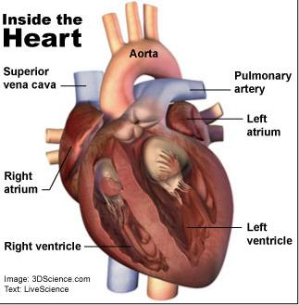
Heart Anatomy
Function of the heart – Ted-Ed Heart
The pump that circulates the blood throughout the body
A very muscular organ about the size of a fist
Notes:
https://ed.ted.com/lessons/how-the-heart-actually-pumps-blood-edmond-hui

Slide 3
1 | Superior Vena Cava
2 | Aorta
3 | Sinoatrial (SA) node
4 | Right Atrium
5 | Atrioventricular (AV) Node
6 | Inferior Vena Cava
7 | Atrioventricular (AV) Valve – Tricuspid Valve
8 | Right Ventricle
9 | Pulmonary Trunk → branches into the pulmonary arteries
10 | Pulmonary Vein
11 | Left Atrium
12 | Atrioventricular (AV) Valve – Bicuspid Valve (also known as Mitral Valve)
13 | Aortic Semilunar Valve
14 | Left Ventricle
15 | Septum
16 | Pulmonary Semilunar Valve

Slide 4
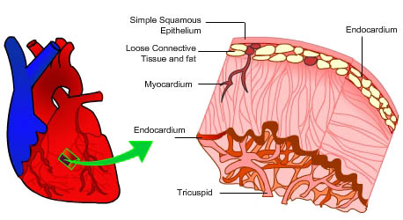
Consists of three tissue layers:
Outer pericardium layer composed of epithelial and fibrous tissue
Pericardium forms a pericardial sac that contains the heart
Has lubricating liquid within the sac
Middle myocardial layer composed of cardiac muscle
Inner smooth endothelial layer

Slide 5
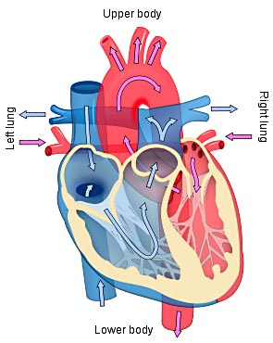
The two pumps
Right side pumps blood to the lungs
Left side pumps blood to the rest of the body
The left and right side of the heart is divided by the septum

Slide 6
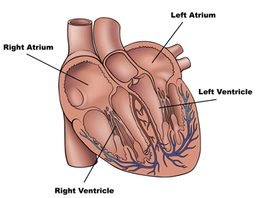
The 4 chambers
There are two chambers on each side of the septum
Smaller chamber, located on the top, is called the atrium (plural = atria)
Larger chamber, located on the bottom, is called the ventricle
Right side is thinner because the lungs are close to the heart
Left side is thicker because the body is further from the heart

Slide 7
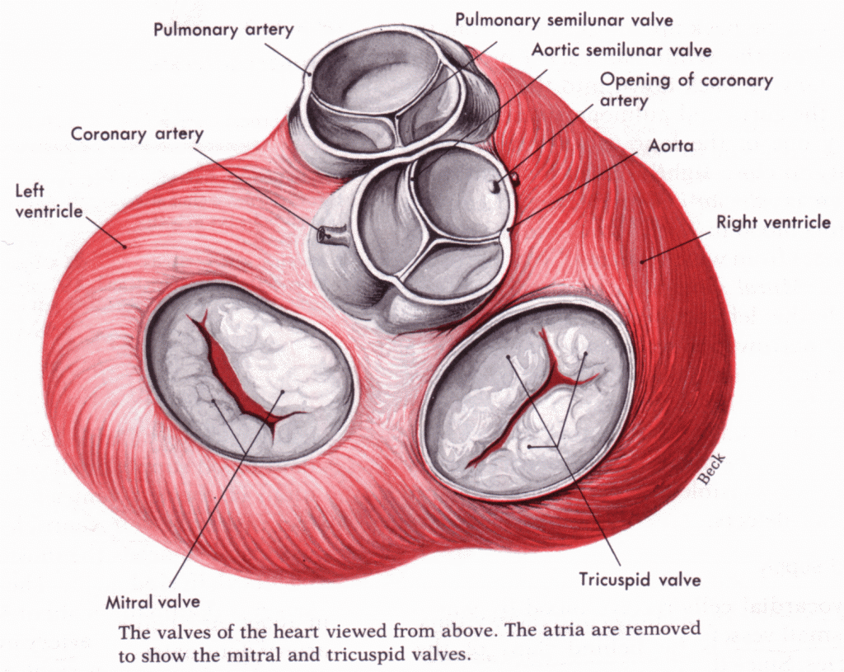
Valves
Atrioventricular valves are located between the atria and the ventricles
Control the flow of blood between the chambers, and prevent blood backflow
Atrioventricular (AV) valve between the right atrium from the right ventricle is called the tricuspid valve (has 3 flaps or “cusps”)
Atrioventricular valve between the left atrium and the left ventricle is called the bicuspid valve or mitral valve (has 2 cusps)

Slide 8
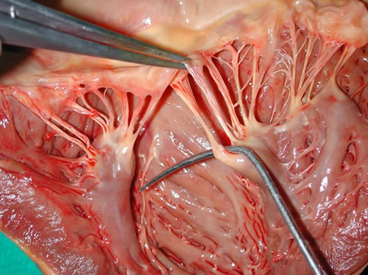
Chordae tendinae are very strong, fibrous strings that support the AV valves and prevent them from inverting

Slide 9
Semilunar valve are located between the heart and the artery
Look like half-moons
Pulmonary semilunar valve is located between the right ventricle and the pulmonary artery
Aortic semilunar valve is located between the left ventricle and the aorta
No chordae tendinae with semilunar valve

Slide 10
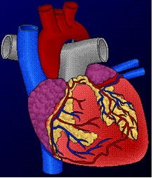
Coronary Arteries & Veins
Vitally important blood vessels that supply blood to the heart muscle itself
Heart does not use the blood in its inner chambers
Arteries branch off the aorta just above the aortic semilunar valve, and lie on the outside of the heart. Ted-Ed Heart Attack
Coronary veins empty into the right atrium
Notes:
https://ed.ted.com/lessons/what-happens-during-a-heart-attack-krishna-sudhir

Slide 11
III. Path of blood through the heart
Animation
Blood low in oxygen (“deoxygenated”) enters the right atrium through the superior and inferior vena cava, the body’s largest veins
The right atrium contracts, forcing blood through the tricuspid valve and into the right ventricles
Notes:
http://www.pbs.org/wgbh/nova/body/map-human-heart.html
http://www.hhmi.org/biointeractive/circulatorium/frames.html

Slide 12
The right ventricle contracts, sending blood through the pulmonary semilunar valve and into the pulmonary trunk

Slide 13
The pulmonary trunk divides into pulmonary arteries, which take the deoxygenated blood to the capillaries of the lungs
At the lungs, carbon dioxide diffuses out of the blood and oxygen diffuses into it. The blood is now oxygenated
The oxygenated blood feeds into the pulmonary veins which take it from the lungs to the left atrium

Slide 14
The left atrium contracts, forcing blood through the bicuspid valve into the left ventricle
The left ventricle contracts, forcing blood through the aortic semilunar valve into the aorta, the body’s largest artery

Slide 15
The aorta divides into smaller arteries, which carry oxygenated blood to all body tissues
Deoxygenated blood never mixes with oxygenated blood
Two atria contract simultaneously and the two ventricles contract simultaneously

Slide 16
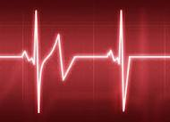
IV. Heartbeat
The heartbeat that you can hear can be divided into two phases:
“Lub” is due to the closing of atrioventricular valves
Atria contracting
Ventricles relaxing
“Dupp” sound is due to the closing of the semi-lunar valves
Atria relaxing
Ventricles contracting

Slide 17
If there is a problem with a valve closing, this can cause heart murmurs
Rheumatic fever caused by a bacterial infection can cause a faulty valve (usually the bicuspid valve)
Surgery or replacement with an artificial valve can often cure this

