Slide 1
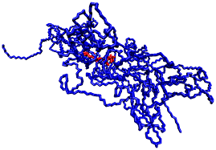
Polymers!

Slide 2
Polymers!
Synthesis and Hydrolysis of Polymers
The most important biological compounds are polymers.
Poly means “many”

Slide 3
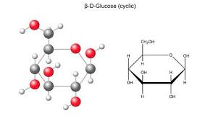
C. Polymers
Many piece chain of subunits (monomers)
Subunits are:
Monosaccharides (simple sugars)
Amino acids
Nucleotides
Fatty acids

Slide 4
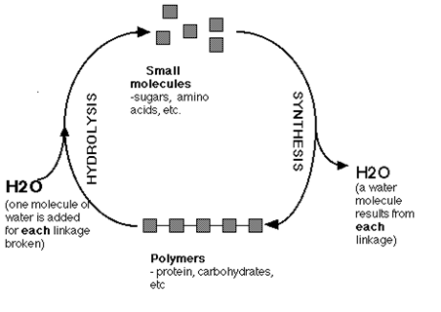
Are made (dehydration synthesis) or broken down (hydrolysis) over and over in living cells

Slide 5
Cells have a common method of joining monomers together to make polymers
Background:
Organic molecules contain carbon (C) and hydrogen (H)
Often organic molecules contain functional groups containing carboxyl (COOH) or hydroxyl groups (OH) or both.
This is important because H and OH can be found hanging off monomers
Monomer
OH
H
Monomer

Slide 6
Dehydration Reaction
Monomer
OH
Synthesis occurs when subunits bond
Following the removal of H₂O
H
Monomer
H₂O
Monomer
Monomer

Slide 7
Hydrolysis Reaction
H₂0
Degradation or hydrolysis occurs when subunits in a Macromolecule separate after the addition of H₂O
Monomer
Monomer
Monomer
OH
H
Monomer

Slide 8
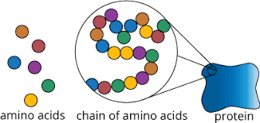
II. Types of Polymers
Proteins: Polymers of Amino Acids
Nucleic Acids (DNA, RNA): Polymers of nucleotides
Carbohydrates: Polymers of monosaccharides
Lipids: Polymers of fatty acids and glycerol

