Slide 1
Amino Acids

Slide 2
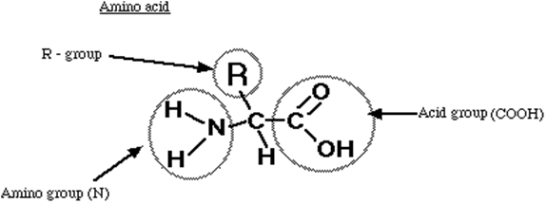
I. Amino Acids
Proteins are changes of amino acids
Basic structure consists of:
Amino group (N)
Acid group (COOH)
R-group (Remainder – this individualizes the amino acid)

Slide 3
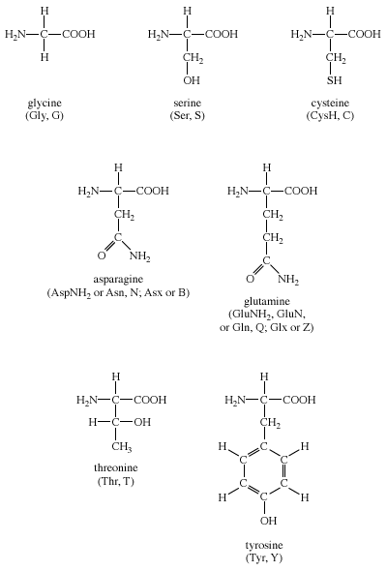
The R – group can vary from a single hydrogen atom (H) to a complicated ring structure

Slide 4
Peptide bond
The bond linking two amino acids forming a dipeptide
Water is given off (dehydration synthesis) to form this bond
H₂O is removed – bond between Nitrogen and Carbon forms a peptide bond

Slide 5
TWO amino acids linked together – dipeptide
THREE amino acids linked together – tripeptide
Many amino acids linked together – polypeptide (30 to 30,000 amino acids)

Slide 6
II. Levels of Protein Organization: Primary, Secondary, Tertiary & Quaternary Structure
Primary structure
Polypeptide chain
Amino Acids linked together
Peptide Bonds
Amino Acids

Slide 7
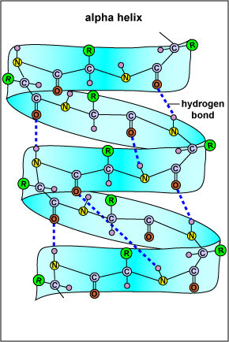
Secondary structure
Hydrogen bonds form between the hydrogen on the amino group and the oxygen in the acid group of close amino acids to twist the first structure in a alpha helix
Coiling is due to hydrogen bonds

Slide 8
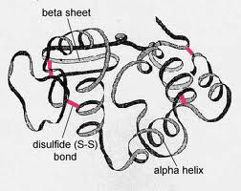
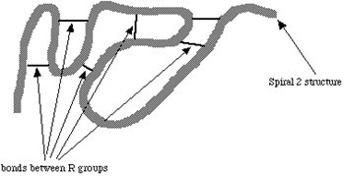
Tertiary structure
The spiral strands folds into a specific shape, due to the various kinds of bonds between R groups
Gives the protein its three dimensional shape (conformation)

Slide 9
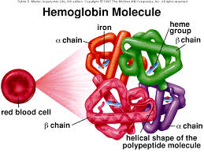
Quaternary structures
Some proteins (fairly often) are actually macromolecules or more molecules (tertiary structures) joined to form a functional protein
Examples:
Hemoglobin - 4 subunits (2 alpha chains and 2 beta chains)
Collagen - 3 helical subunits coiled together
Animation
Notes:
Multiple tertiary proteins joined together to form quaternary structures

Slide 10
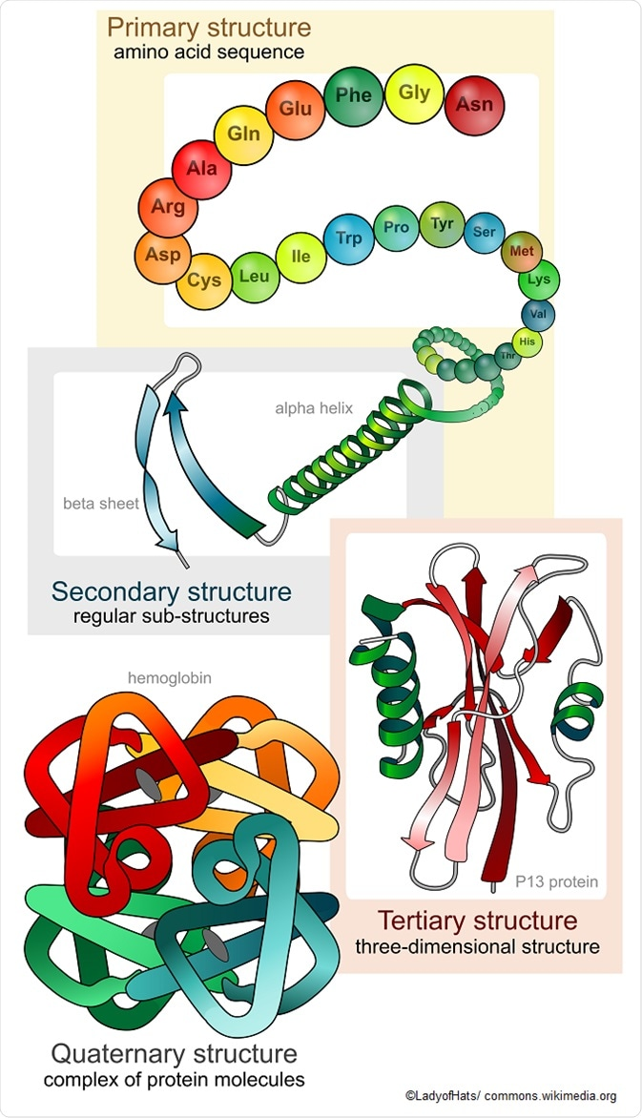

Slide 13
Denaturation
Loss of protein’s tertiary structure by breaking R group bonds
Protein LOSES shape and function, becoming denatured
Caused by:
Temperature Animations Unboil
pH change
Heavy metals (ex. Lead, Mercury)
Example:
Heating an egg white
Adding vinegar to milk
Notes:
Heating an egg white → raising the temperature above 50C will reliably denature most animal enzymes
Adding vinegar to milk → this is the same thing as changing the pH, since vinegar is an acid

Slide 14
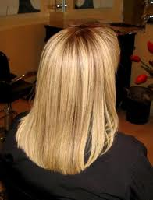
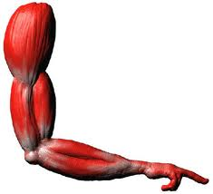
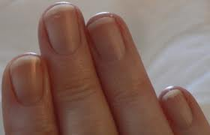
III. Functions of Proteins
Polymers of Amino Acids
Have 3 major functions
Structure & Movement
Kertin – hair, nails
Collagen – cartilage, tendons
Actin, Myosin – muscle tissue

Slide 15
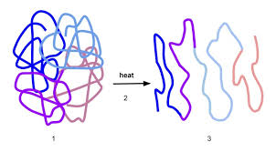
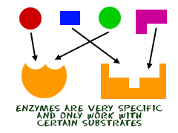
Metabolism
Enzymes
Are catalysts
speed up chemical reaction and allow to happen at a lower temperature
Therefore critical to all cell activity
Antibodies & Hormones

