Slide 1
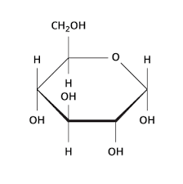
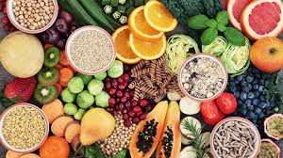
Carbohydrates

Slide 2
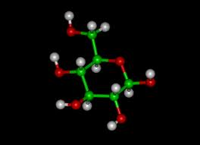
I. Carbohydrates
Empirical Formula (CH₂O)_{n}
A repeating chain of sugars (saccharides)
Polysaccharides – Many saccharides linked together
To break the bond between two sugars, a H₂O is added back (hydrolysis)
Carbs/Health Ted-Ed
Notes:
https://ed.ted.com/lessons/how-do-carbohydrates-impact-your-health-richard-j-wood#review

Slide 3
Many functions of carbohydrates are:
Energy
Bonds between atoms can be broken, the hydrogen atoms stripped off and the energy released can be used by cells
Structural
Cellulose is a major structural compound in plants
Use in the cell wall

Slide 4
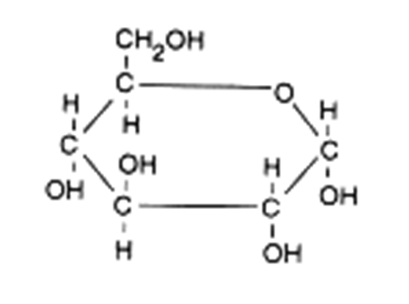
II. Glucose
A basic sugar
C₆H₁₂O₆
Has a ring structure
This is a mono (one) saccharide
Others include fructose, ribose, deoxyribose etc…
Animation: Ted Ed Sugar
How Sugar affects Brain: Ted Ed
Notes:
http://ed.ted.com/lessons/sugar-hiding-in-plain-sight-robert-lustig
https://ed.ted.com/lessons/how-sugar-affects-the-brain-nicole-avena

Slide 5
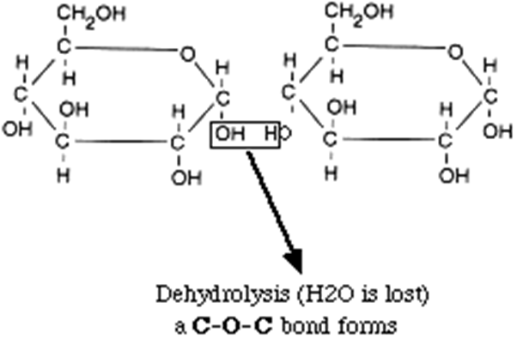
III. Dissacharide
Two sugars joined together
Examples of disaccharides:
Maltose (two glucoses)
Sucrose (a glucose and fructose)
Lactose (galactose and glucose)

Slide 6
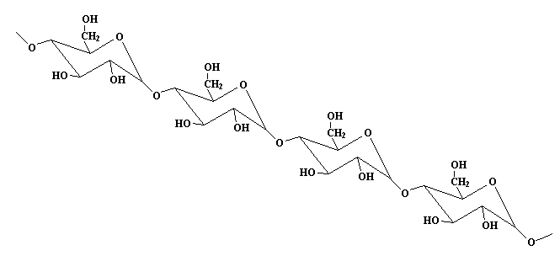
IV. Three Important Polysaccharides
Starch
Main storage form of sugar in plants
Few side chains
Many glucose molecules linked together

Slide 7
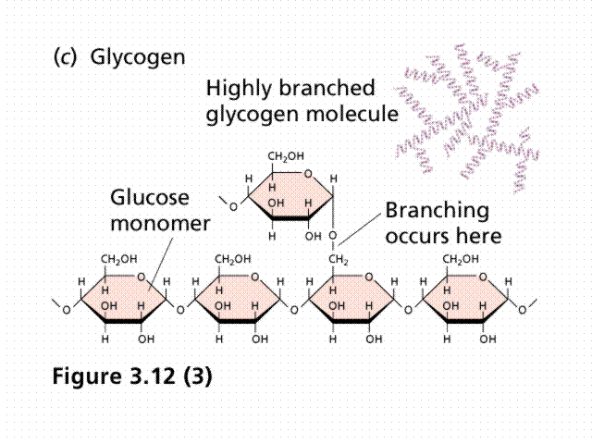
Glycogen
Main sugar storage in animals
Many side chains
Linked as for starch

Slide 8
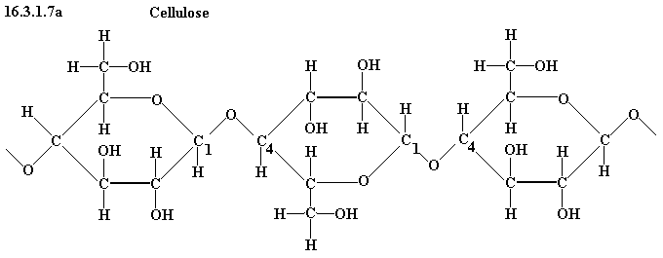
Cellulose
Structural (cell walls)
Long chains
Linkage between Carbon atoms of adjacent chains sugars is different than starch and glycogen
No mammals can break this bond

