Slide 1
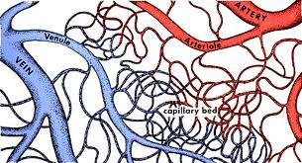
Capillary – Tissue fluid exchange
Exchange of Gases
  Oxygen
    95% is carried by oxyhemoglobin (HbO₂)
      200 million hemoglobin molecules per RBC
      Each hemoglobin carries four oxygen molecules
    5% dissolved in plasma
  Animation
Notes:
http://www.youtube.com/watch?v=Q530H1WxtOw
Pg. 112

Slide 2
Carbon dioxide (CO₂)
  9% dissolved in plasma
  27% picks up CO₂ to form carbaminohemoglobin (HbCO₂)
  64% of CO₂ is transported as bicarbonate ion (HCO₃⁻)
    It is formed after CO₂ combines with water, forming carbonic acid which then dissociates
    Note the following reaction: CO₂ + H₂O ← → H₂CO₃ ← → H⁺ + HCO₃⁻
    The enzyme carbonic anhydrase speeds up this reaction
    The H⁺ released by reaction changes the blood pH
    To prevent this H⁺ is picked up by the globin portion of hemoglobin (to become HHb) so that pH is maintained

Slide 3
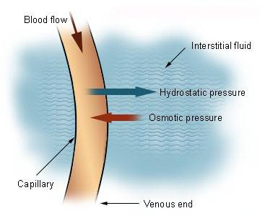
II. Mechanism of Gas Exchange
Intro Animation
Due to a pressure differential between blood pressure and osmotic pressure
Blood pressure is the pressure of blood in blood vessel would tend to push molecules out of the blood
Notes:
http://highered.mcgraw-hill.com/sites/0072507470/student_view0/chapter21/animation__fluid_exchange_across_the_walls_of_capillaries.html

Slide 4
At arterial side of a capillary bed, blood pressure is (40 mm Hg) higher than blood osmotic pressure (25 mm Hg)
Thus plasma consistently “leaks” out through the walls of the capillaries, forming interstitial fluid that bathes tissues
  The interstitial fluid contains water, nutrients, hormones, gases, wastes.
  Plasma proteins and blood cells are too big so they are left behind in the capillaries.

Slide 5
Oxygen, sugars and amino acids in the fresh plasma diffuse into/taken up by local cells
CO₂ and waste molecules produced in the tissue cells diffuse out of the tissue and into the interstitial fluid

Slide 6
Osmotic pressure is the opposing force trying to force molecules into the blood
  At the venule side of the capillary beds, blood pressure is now reduced (10 mm Hg) whereas osmotic pressure is about the same (25 mm Hg)
  Therefore, water, ammonia and carbon dioxide laden interstitial fluid is now pulled by osmotic pressure back into the blood vessels tend to enter the bloodstream
  Osmotic pressure is basically constant, but blood pressure varies considerable around a capillary bed. This causes some natural movement of molecules

Slide 7
Transport fluids
Body Fluids
  Human beings are approximately 70% water by body weight
  Most of the water is within cells
  A smaller amount of water is found within:
    Tissue fluid (surrounds cells)
    Lymph vessels
    Blood vessels
Notes:
Pg. 120

Slide 8
Blood
  Blood is a liquid connective tissue
  Average person has about 5 to 6 liters of blood
  Blood is required by the body to maintain homeostasis
  Blood functions in
    Transport of gases, waste, and nutrients
    Clotting to seal injuries
    Infection fighting

Slide 9
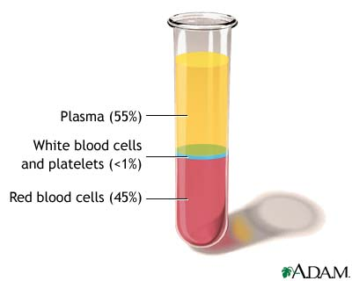
Two main components of blood
  Plasma (the liquid portion of blood)
    Makes up about 55% of blood volume
    Contains water
    Contains organic and inorganic substances (proteins, gases, salts, nutrients, wastes)

Slide 10
Formed elements (the solid part of blood)
  Makes up about 45% of blood volume
  About 30 trillion blood cells in an adult

Slide 11
Each cubic millimeter of blood contains 2 main types of formed elements
  Red blood cells (RBC)
    4 – 6 million per mL of blood
    More RBC/mL in males than females
    Number of blood cells is related to O₂ concentration in air
    Ex. People who live at high altitudes have more RBC
    Increasing the number of RBC/mL can aid athletic performance (“blood doping”)

Slide 12
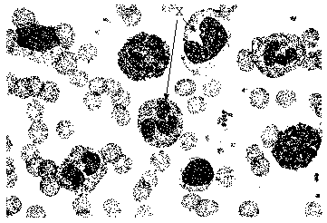
White blood cells
  Average total of 7,500 per mL of blood

