Slide 1
The Scientific Method

Slide 2
How do scientists make their discoveries?
http://www.youtube.com/watch?v=jPaGOHwv7mQ

Slide 3
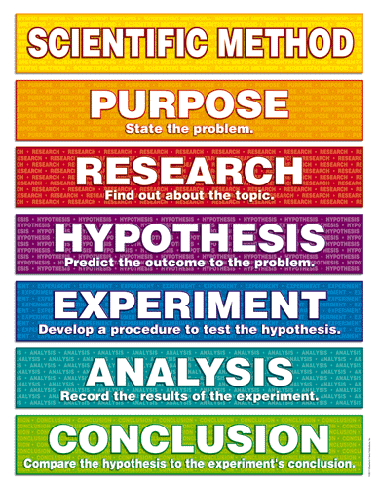

Slide 4
What is the purpose of this experiment?
What do we want to figure out?

Slide 5
What other experiments have taken place?
Are there any limitations or other possibilities to what you want to discover?

Slide 6
What do you think is going to happen?
If…, then…
Example: If a plant receives water, then it will grow faster.

Slide 7
What are the steps that must be taken for this experiment?
Consists of an extremely detailed list of materials necessary as well as a detailed list of steps for the procedure

Slide 8
What results occurred from your experiment?
Must have results from the original conditions.
Compare to results from when the change was made.

Slide 9
What did you discover?
Was your hypothesis supported or not supported?
What factors may have affected your result?
If you were to redo the experiment, what changes would you make?

