Slide 1
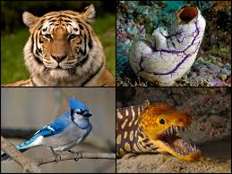
Phylum Chordata
Vertebrates

Slide 2
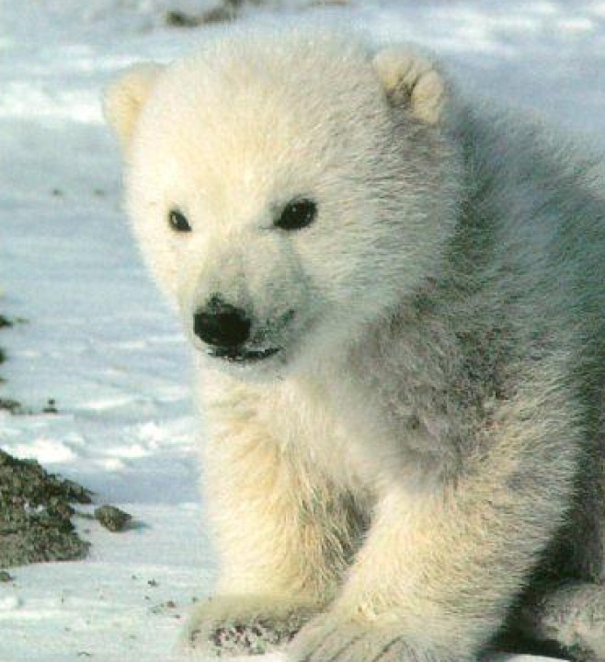
What are Chordates?
Part of the phylum Chordata
Both Vertebrates and Invertebrates
Vertebrates in subphylum Vertebrata
Contain a backbone
Invertebrates in two subphylum: Tunicates and Lancelets
Do not have backbone

Slide 3
Shared Characteristics of Vertebrates.
Notochord : Long flexible supporting rod that runs on the dorsal part of the body.
Hollow Dorsal Nerve Chord : Long Nerve cord that runs on the dorsal side encased by the backbone
Paired Appendages
Pharyngeal gills and Lungs: Breathing Structures

Slide 4
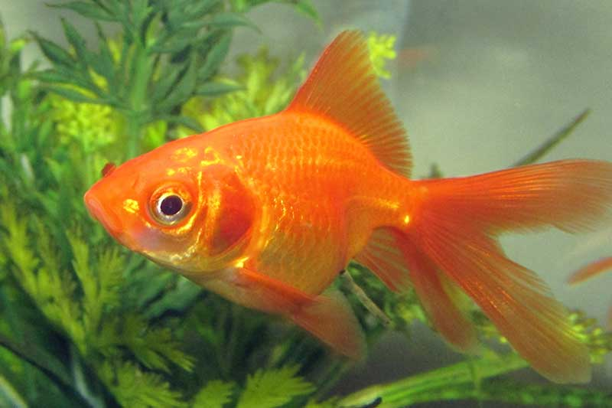
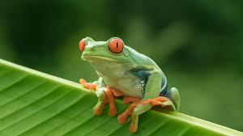
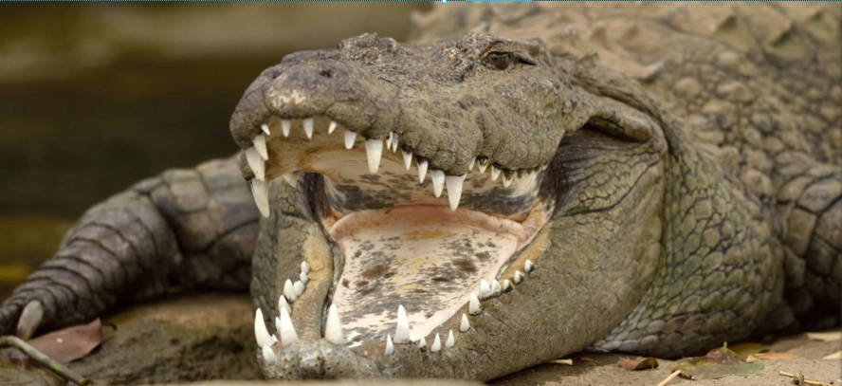
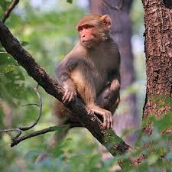
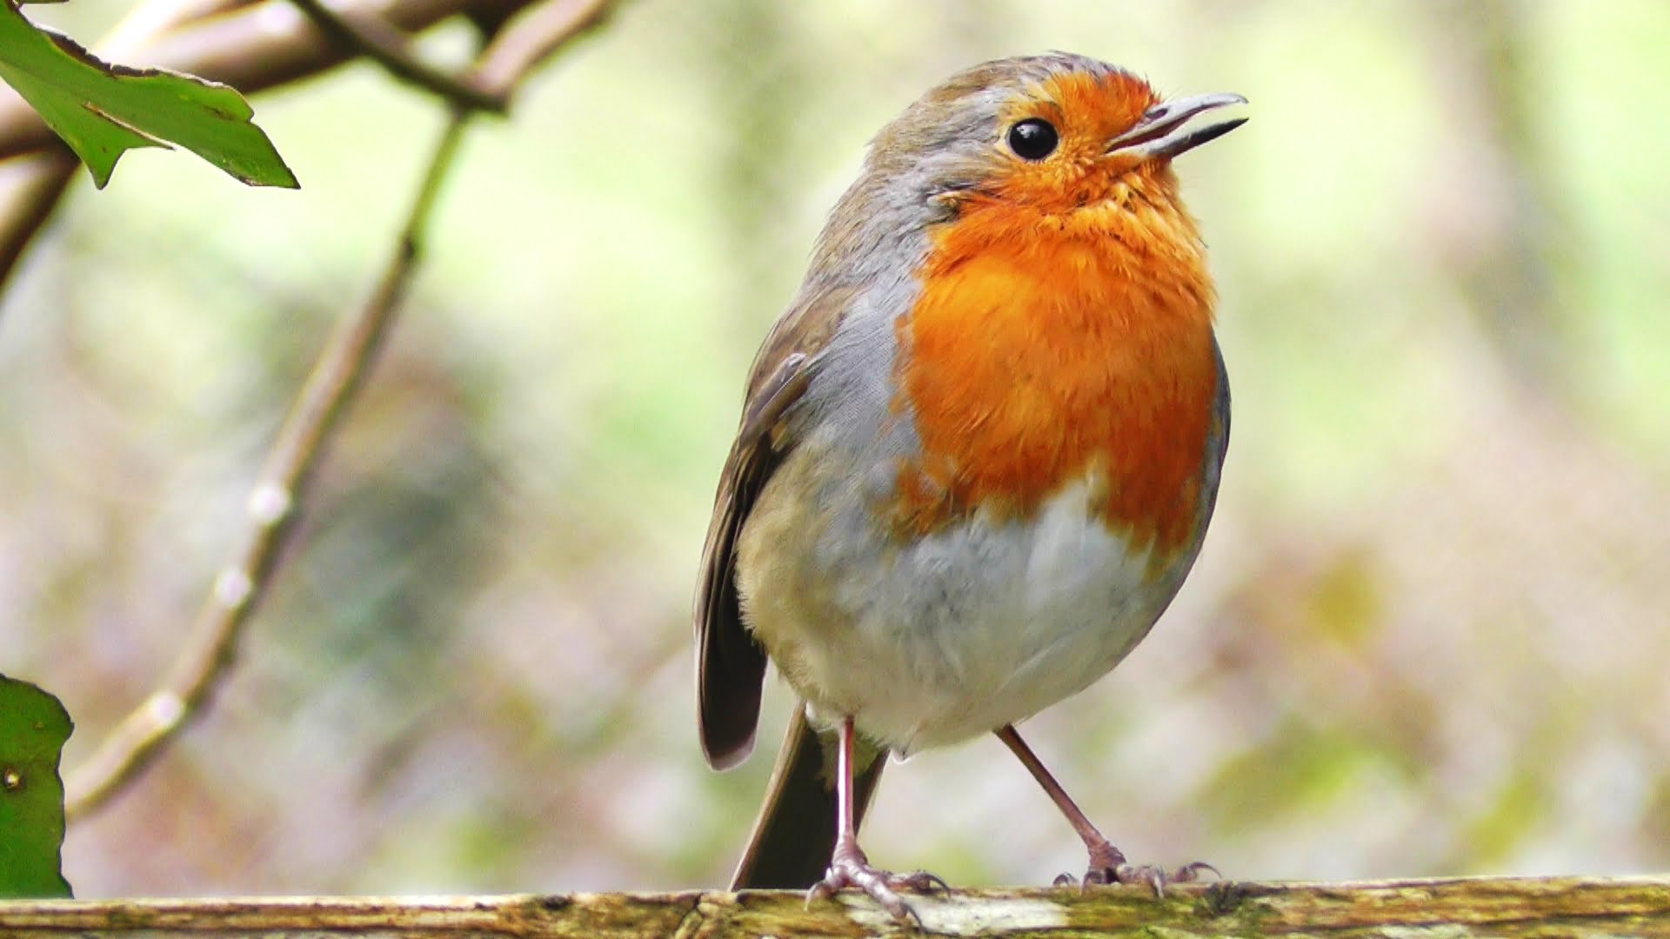
Five groups
Fishes
Amphibians
Reptiles
Birds
Mammals

Slide 5
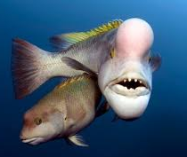
1) Fishes
Characteristics
Aquatic(salt and fresh)
Fins & Scales
Pharyngeal Gills
3 main Groups of Fishes
Jawless Fishes
Bony Fishes
Cartilaginous Fishes – skeleton made up of cartilage rather than bone

Slide 6
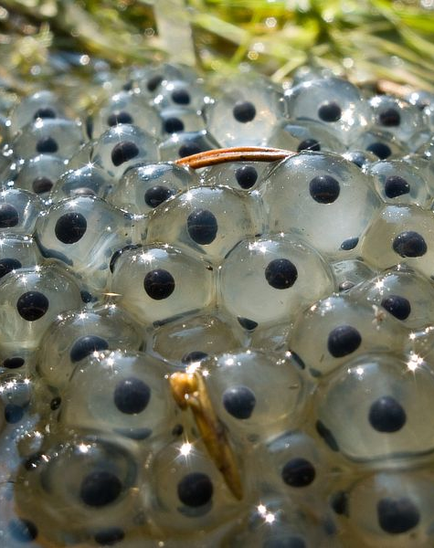
2) Amphibians
Name: Amphi = Both, Bio = Life
Mainly found in moist areas
Examples: Toad, salamander, frog
Characteristics:
Ectothermic
Aquatic as larvae and Terrestrial as adults
Eggs do not have hard shell
Eggs must stay moist to survive

Slide 7
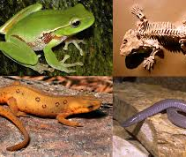
2) Amphibians
Breathe with lungs as adults
Larvae are fish-like and breathe through gills
Adults breathe with lungs and skin
Moist skin
Skin contains mucous glands that keeps skin moist
Able to breathe with skin if moist
Lack scales and claws

Slide 8
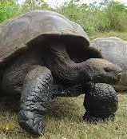
3) Reptiles
Widely dispersed – Only area where reptiles do not live are very cold temperatures
Adapted to life on land
Examples: Snakes, Crocodiles, Turtles
Characteristics:
Lungs
Dry skin helped develop two effective lungs
Do not use skin-gas exchange like amphibians

Slide 9
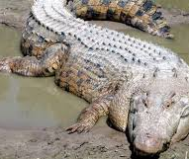
3) Reptiles
Scaly Skin
Dry, leathery skin that is thick.
Helps prevent water loss
Shred skin to grow
Specialized Eggs
Surrounded by a shell and several membranes
Contains Yolk

Slide 10
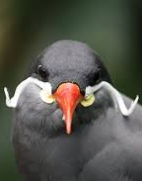
4) Birds
Main difference: Feathers
Characteristics:
Body Covered in feathers
Front Limbs have adapted to wings
Have Beaks
Endothermic

Slide 11
4) Birds
Different types of feathers
Contour Feathers: Cover the birds body and wings
Long and stiff
Down Feathers: Grow underneath and between contour feathers
Short and soft
Powder Feathers: For birds that live in water - waterproof

Slide 12
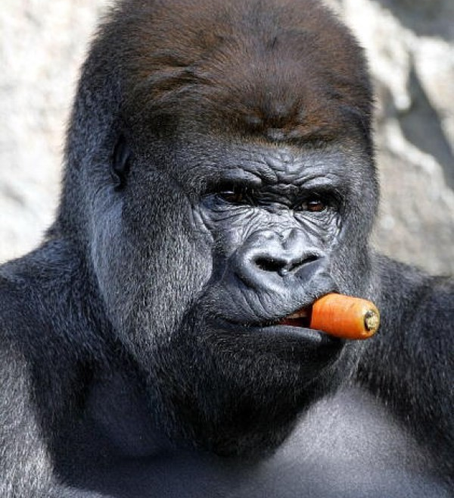
5) Mammals
We are Mammals!
Both Aquatic and Land animals
Characteristics:
All Mammals are Viviparous
Born alive and develop with their mother when they are born
Female Mammals have Mammary glands
Able to produce milk to nourish young

Slide 13
5) Mammals
Teeth and Jaws
Many variations of teeth and jaws depending on the feeding habits
Well developed breathing system
Have diaphragm that is able to separate respiratory system and internal organs

Slide 14
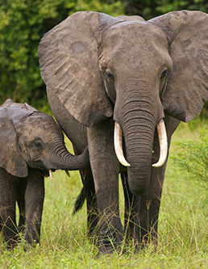
Different Types of Mammals
1. Marsupial Mammals
Born early in uterus development
Live in mothers pouch or fur in early youth stages
Attach themselves to nipple to continue development
Example: Kangaroo
2. Placental Mammals
Embryo develops in uterus until birth
Example: primates, elephant

Slide 15
Different Types of Mammals
3. Monotreme Mammals
Hatch from eggs
Example: duck-billed platypus, echidna

