Slide 1
Continental Drift

Slide 2
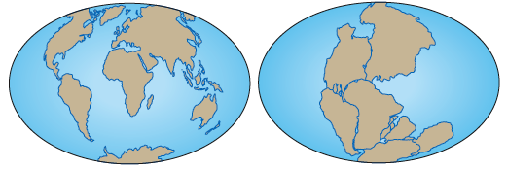
Name all 7 continents
North America
South America
Africa
Antarctica
Australia
Europe
Asia

Slide 3
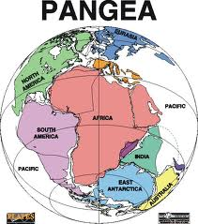
Pangaea
Pangaea is the name for the original super continent.
Pan → all
Gaea → Earth
The continents looked like they might fit together like puzzle pieces,
In the early 20th century, German scientist Alfred Wegener developed the continental drift theory.

Slide 4
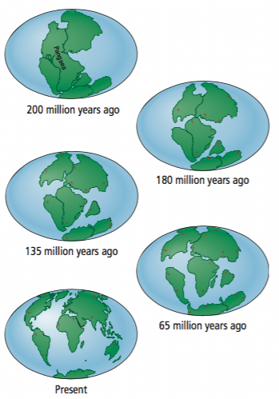
Pangaea

Slide 5
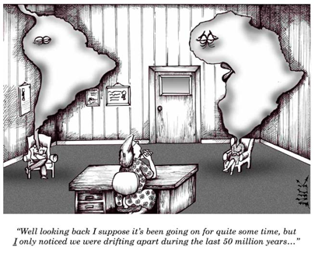
Continental Drift Theory
States that the continents have not always been in their present locations but have “drifted” there over millions of years.
Wegener’s first clue that the continents were in motion came from his and others’ observations of world maps.

Slide 6
Evidence for Continental Drift
Jigsaw Puzzle Fit
The apparent match on a world map between South America’s eastern coastline and Africa’s western coastline.
The fit appeared too close to be coincidental.

Slide 7
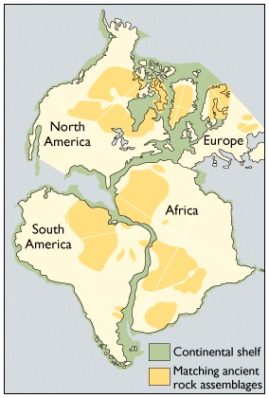
Evidence for Continental Drift
Matching geologic features and rocks on different continents
Mountain ranges that begin on one continent, end at the coastline, and then appear to continue on a continent across an ocean.
Ex. Same rocks found in Newfoundland and Greenland.

Slide 8
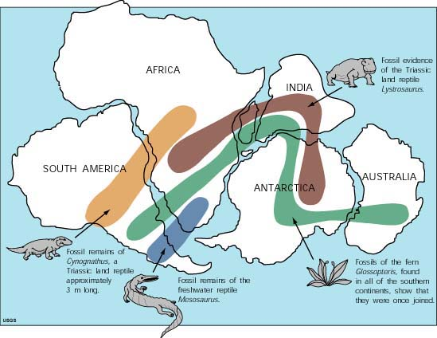
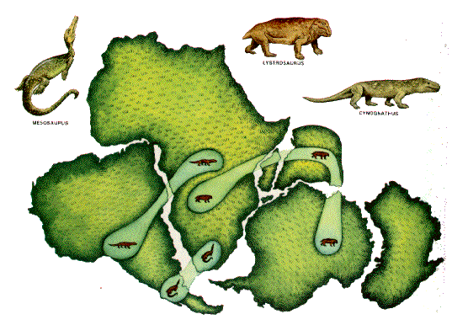
Evidence for Continental Drift
Matching fossils on different continents around the world
The same fossil was found in South America and Africa.
Various plants found on continents separated by vast oceans.

Slide 9
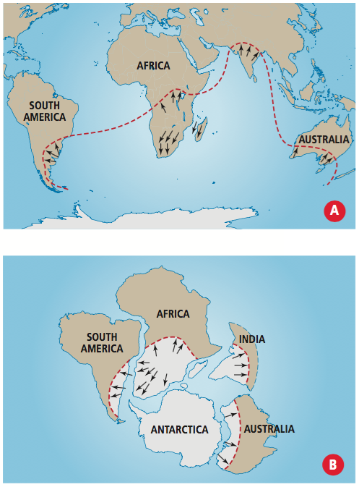
Evidence for Continental Drift
Paleoglaciation
Glaciers leave markings as they move.
These markings left by glaciers are now found in parts of the world that are now tropical.

Slide 10
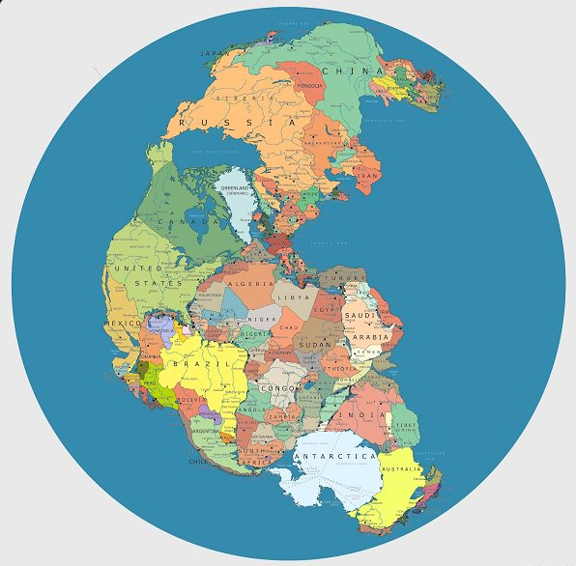
Evidence for Continental Drift
Coal Deposits
Coal forms from decomposition of living things in tropical areas.
Coal deposits were found in Antarctica which suggests that it once had a warmer climate.
Therefore Antarctica must have been situated in a different location on the planet.

Slide 11
Summary Questions
In your own words, describe continental drift theory.
List and describe the pieces of evidence that support Wegener’s continental drift theory.
What was Pangaea and what does the word mean?
Explain how the presence of coal deposits in northern Canada support the continental drift theory.

Slide 12
Summary Questions
A scientist discovers a fossil on the west coast of Africa. She searches the east coast of South America for the same fossil. Using the timeline, explain why she may or may not find the fossil.
Looking at the diagram on the right and using what you have learned about continental drift, predict and draw what you think the Earth will look like in 50 million years from today.

