Slide 1
Layers of the Earth

Slide 2
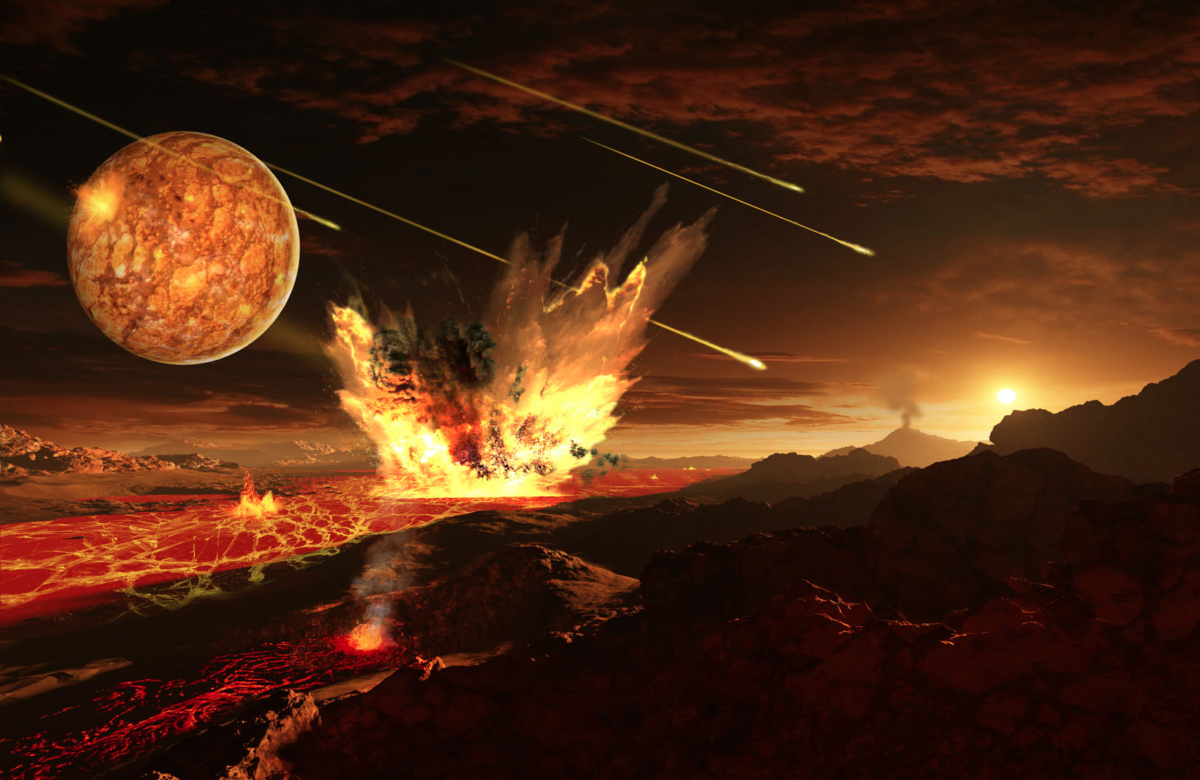
Early Earth
Scientists believe that Earth began as a molten ball over 4.5 billion years ago.
As Earth cooled, the less dense materials floated to the surface and the heavier materials sank toward the interior.
The less dense elements (ex. silicon and oxygen) floated to the top and formed the layer we know today as the crust.

Slide 3
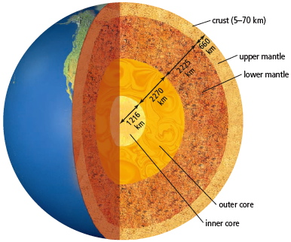
Layers of the Earth
Crust
State: solid
Thickness: 5-70km
Composed of: granite and basalt

Slide 4
Layers of the Earth
Mantle
State: liquid
Thickness: 2900 km
Composed of: molten rock containing iron and magnesium

Slide 5
Layers of the Earth
Outer Core
State: liquid
Thickness: 2300 km
Composed of: iron and nickel

Slide 6
Layers of the Earth
Inner Core
Earth’s center
State: solid (because under high pressure)
Temperature: 5000 – 6000ºC
Thickness: radius of about 1200km
Composed of: mostly iron

Slide 7
Layers of the Earth
Why Does The Earth Have Layers?

Slide 8
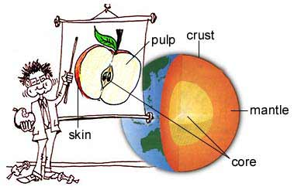
Plate Tectonic Theory
Earth’s outer layer is comprised of several large, rigid but mobile chunks called tectonic plates.
There are 12 tectonic plates that make up the crust.
Divided into:
Continental plates
Oceanic plates

Slide 9
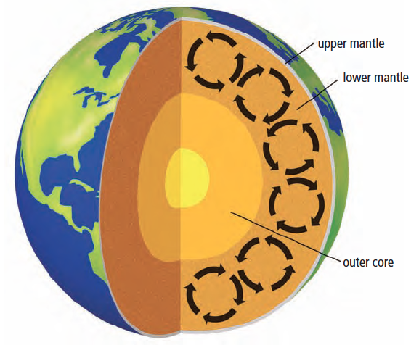
Plate Motion
Convection Currents
After watching the video, write down any observations that you made.
From what you have learned so far about KMT, provide an explanation of your observations.

Slide 10
Convection Currents
The liquid in the mantle closest to the hot core is heated which makes it less dense.
This low density fluid rises towards the crust where it is cooled.
The colder liquid is now more dense and sinks again where it is reheated.
This cycle continues and creates what we call a convection current.
This convection is the driving force behind plate movement.

Slide 11
Summary Questions
Compare the Earth to an avocado. What are the similarities and differences?
How does state (solid, liquid, gas) of the mantle affect plate movement?
How would the Earth be different if the mantle was a solid?
How would the Earth be affected if the core cooled down?
Create a foldable of the Earth’s layers. Label each layer and include a thorough description of each layer (thickness, characteristic, state etc.)

