Slide 1
The Ray Model of light

Slide 2
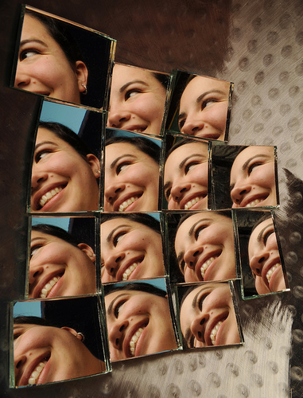
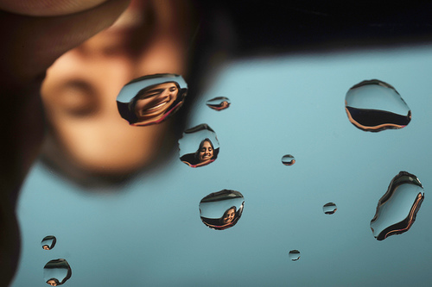
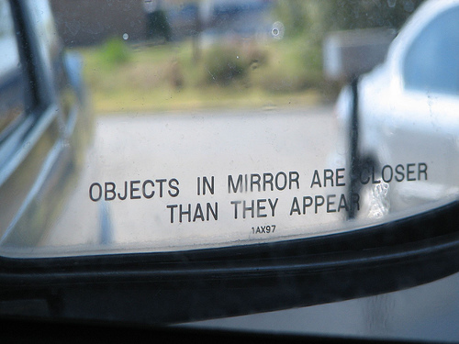

Slide 3
The Ray Model of Light
Light is represented as a straight line, or ray, that shows the direction the light wave is travelling.
You can use this model to show what happens when light strikes different materials.

Slide 4
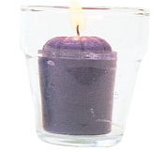
Three things happen when light strikes a material…
The light may be transmitted (pass straight through it)
The material is TRANSPARENT
What are some other materials that are transparent?

Slide 5
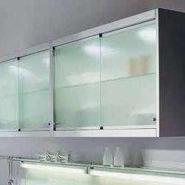
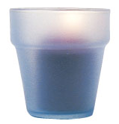
The light may be reflected (bounce off it).
The material is TRANSLUCENT
What are some other materials that are translucent?

Slide 6
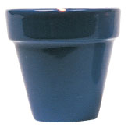
The light may be absorbed (become “trapped” in it).
The material is OPAQUE.
What are some other materials that are opaque?

Slide 7
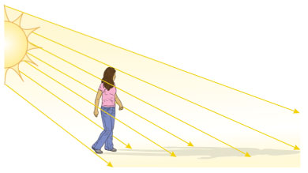
Shadows
We can use the ray model to predict:
Where shadows will form
How large they will be.

Slide 8
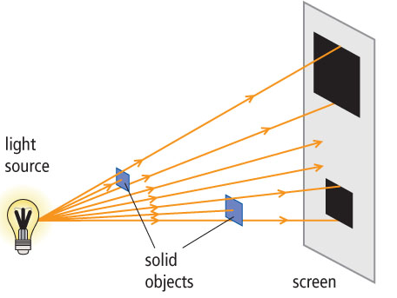
A ray diagram can be used to show how the size of shadows is related to the distance of the object from the light source.
The closer the object is to the light source, the larger the shadow.

Slide 9
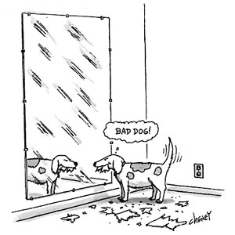
The Law of Reflection
The angle of reflection equals the angle of incidence

Slide 10
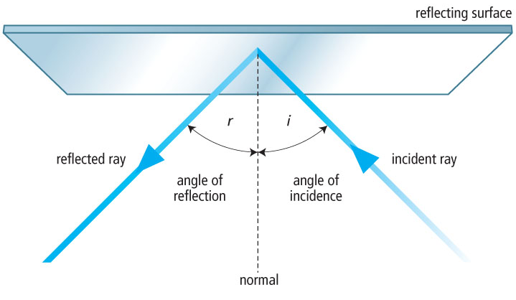

Slide 11
Incident Ray
The light ray that strikes the reflecting material
Reflected ray
The light ray that is bounced back (reflected) from a reflecting surface
Normal
An imaginary line drawn perpendicular to a reflecting surface at the point where an incident ray strikes the surface

Slide 12
Angle of Incidence
Labelled i
The angle formed by the incident ray and the normal
Angle of Reflection
Labelled r
The angle formed by the reflected ray and the normal

