Slide 1
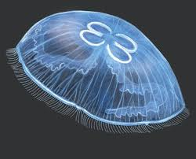
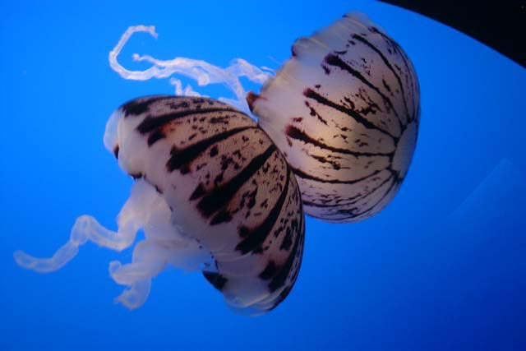
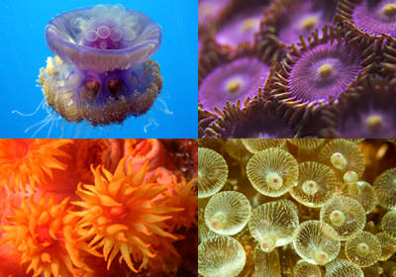
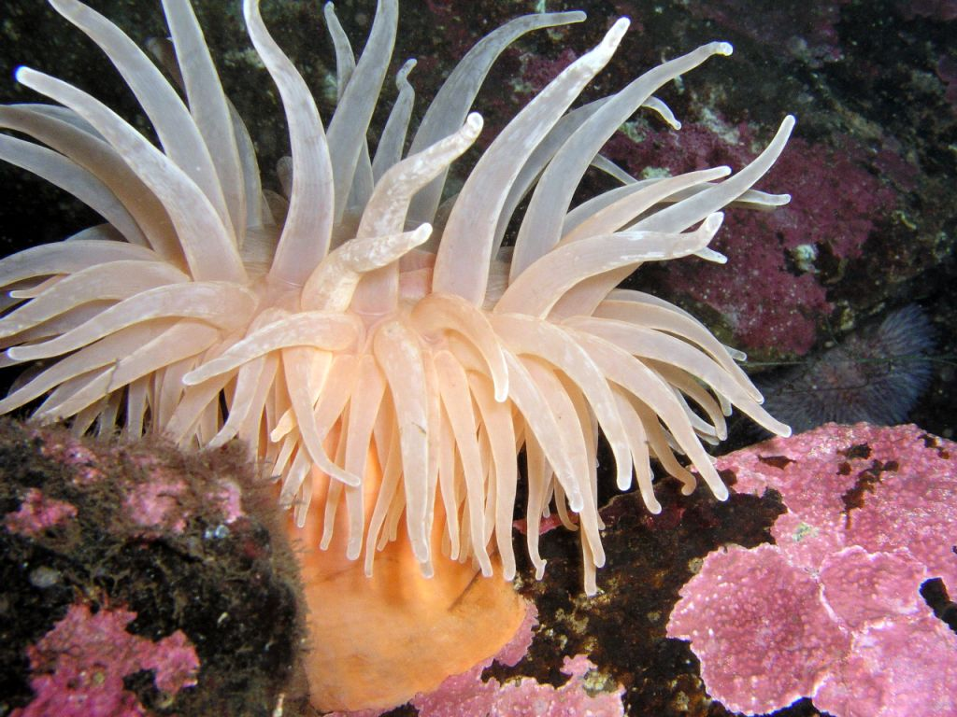
26-3 Cnidarians

Slide 2
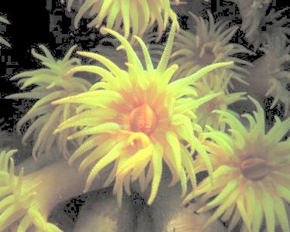
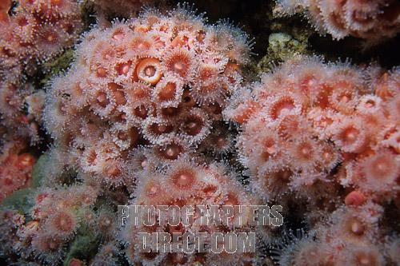
I. What is a Cnidarian?
A. Characteristics of Phylum Cnidaria:
1. Soft-bodied
2. Stinging tentacles arranged in circles around their mouth
3. Live as single individuals or as a group connected into a colony

Slide 3
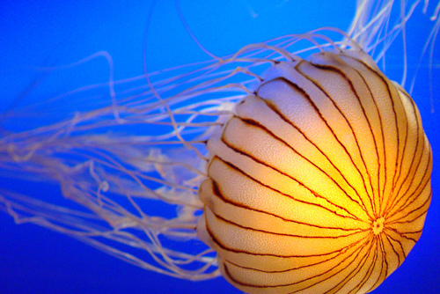
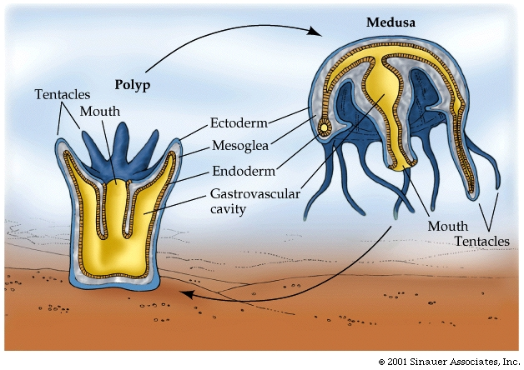
Symmetry: radial
Have specialized cells
and tissues
6. Life cycles with two stages: animation
a) Sessile flowerlike polyp b) Motile bell-shaped medusa

Slide 4
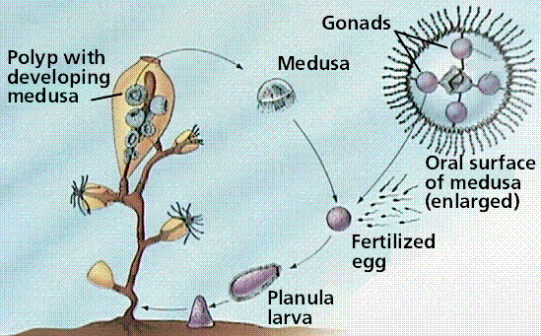
Cnidarian Life Cycle

Slide 5
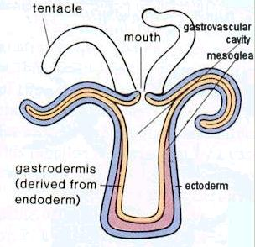
B. Body Plan
1. Have a body wall that surround an internal space called the gastrovascular cavity
a) Function of cavity: digestion

Slide 6
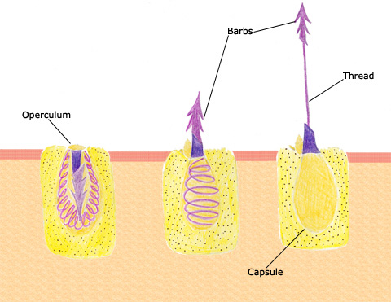
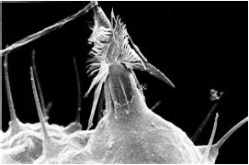
II. Form and Function in Cnidarians
Nematocyst: stinging structure on the tentacles of cnidarians that is used to paralyze or kill prey
TED-Ed How Jellyfish Sting
1. Each nematocyst is a poison-filled sac containing a tightly coiled "spring-loaded" dart
Nematocysts in action
Nematocysts explained

Slide 7
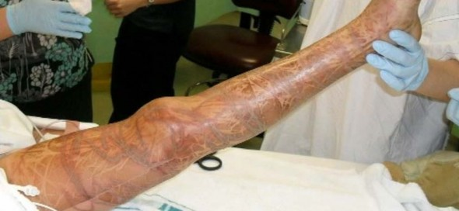
Stung by a box jellyfish

Slide 8
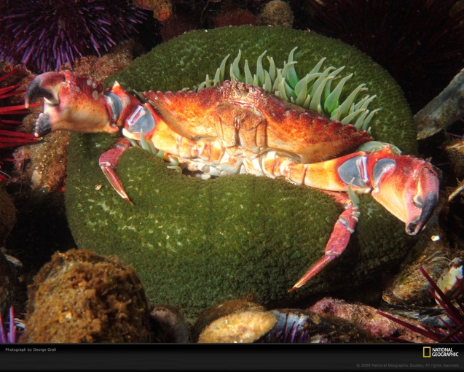
2. Feeding/Digestion:
a) When another animal touches a nematocysts,
the dart explodes and buries itself in the skin of the animal
b) The dart carries enough poison to paralyze or kill the prey.

Slide 9
c) The cnidarian's tentacles push the food
through the mouth and into the gastrovascular cavity.
There the food is broken up into tiny pieces. These food fragments are taken up by cells in the gastroderm that digest them further
Video – Anemone Eating Dead Shrimp

Slide 10
e) The nutrients are then transported throughout the body by diffusion
f) Undigested material passes out through the
gastrovascular cavity.

Slide 11
Form and Function in Cnidarians Cont’d..
B. Respiration by diffusion
C. Excretion by diffusion
D. Nervous System
1. Composed of nerve nets concentrated around the mouth
2. Sensory cells are in the epidermis
a) Detect chemicals from food
b) Detect touch of foreign objects

Slide 12
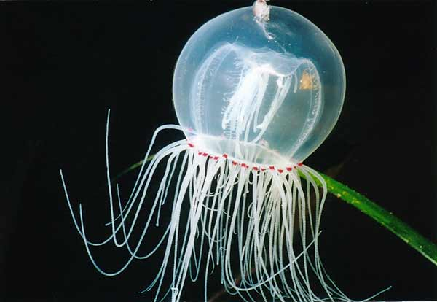
3. Medusae may have simple sense organs:
a) Statocysts involved with balance
b) Ocelli, or Eyespots, detect light

Slide 13
E. Movement
1. Cnidarians lack muscle cells.
2. Epidermal cells can change shape when stimulated by nerve net
3. Polyps can expand, shrink and move their tentacles by relaxing or contracting these cells
4. Medusae can move by jet propulsion by causing their bodies to "close" like a folding umbrella. This contraction of the body pushes water out of the bell
Jellyfish Swimming

Slide 14
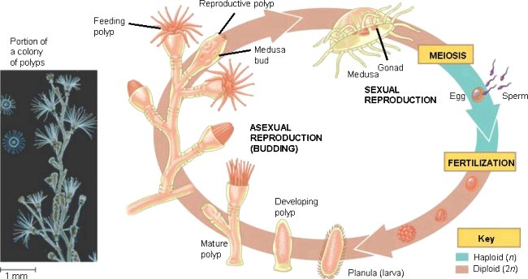
F. Reproduction
1. Describe asexual reproduction:
Budding - begins with a swelling on the side of an
existing individual

Slide 15
.
2. Describe sexual reproduction: Video
When the medusae mature, they reproduce sexually by releasing gametes into the water.
Fertilization occurs either in open water or inside an egg-carrying medusa. They zygote grows into a ciliated larva that swims around and settles down, attaches to a surface, and changes into a polyp

Slide 16
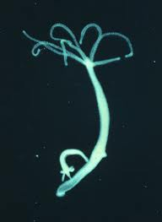
III.Hydras and Their Relatives
A. Class: Hydrozoa
B. Spend most of life as polyps:
C. Grow in branching, sessile colonies
D. Hydras
1. Hydras are not typical Class Hydrozoa because they live as solitary polyps and lack the medusa stage in their life cycle.
2. Hydras can move by doing a somersaulting movement
3. Reproduction:
a) Asexual: budding
b) Sexual: producing of eggs and sperm in their body walls

Slide 17
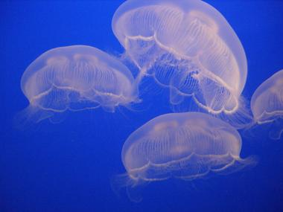
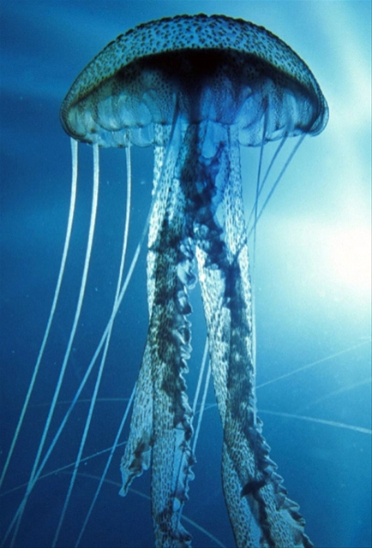
IV. Jellyfish
A. Class: Scyphozoa
B. The medusa is large & long-lived (dominant)
C. Nematocysts mostly harmless to humans; some can cause painful stings or death

Slide 18
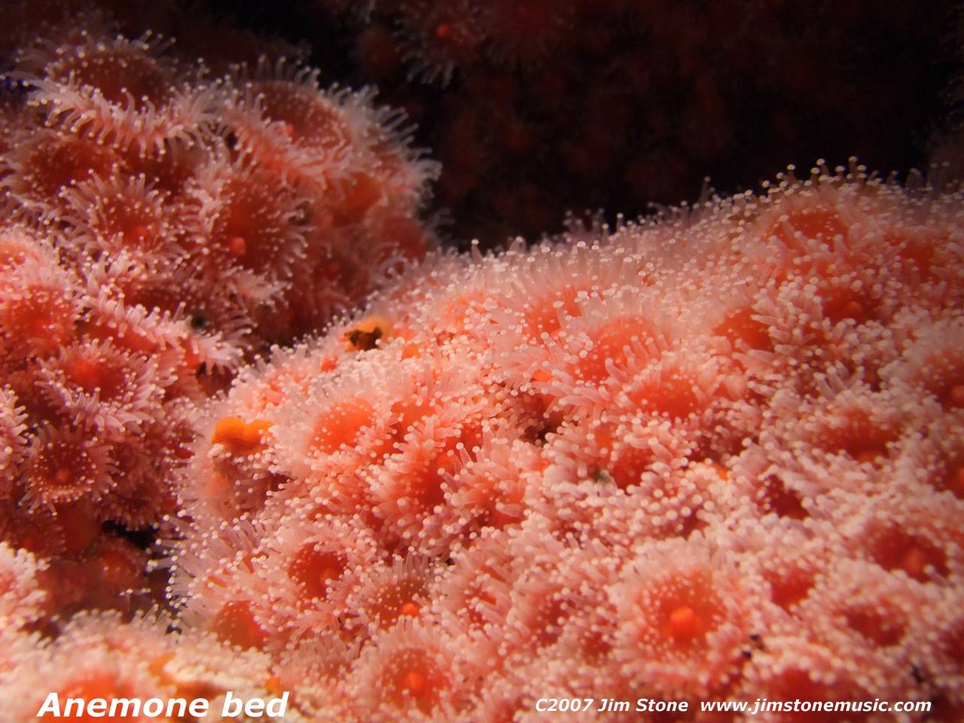
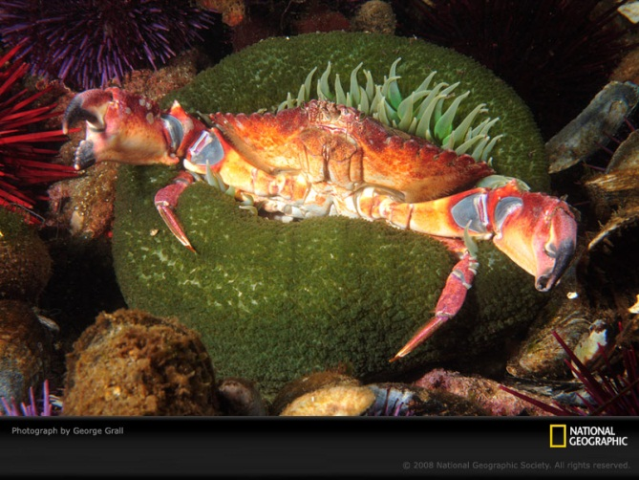
V. Sea Anemones and Corals
A. Class: Anthozoa
B. Life Cycle: only the polyp stage
C. Sea anemones:
1. Habitat: sea from the low-tide line to great depths

Slide 19
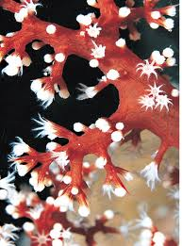
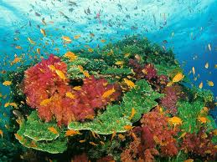
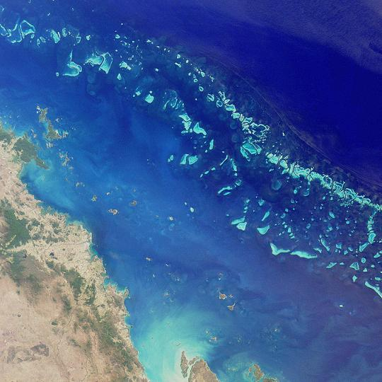
D. Corals: Video
1. Habitat: shallow tropical waters
2. Skeleton: made of calcium carbonate (limestone)
3. Colonies produce coral reefs, which can contain
more rock and living tissue than the largest human
Cities
e.g.: The Great Barrier Reef (Australia) is more than 2000 km long and 80 km wide

Slide 20
VI. How Cnidarians Fit into the World
A. Coral Reefs: TED-Ed Coral Reef
1. Ecological importance: provide tunnels, caves and deep channels for other animals to live TED-Ed Coral Reef 2
2. Benefits to Humans:
a) Provide a home for food organisms
b) Protect the land from the destructive action of waves
c) Aids in the location of oil deposits

Slide 21
B. Chemicals:
1. Potential anti - cancer drugs
2. Nerve toxins reveal how nerve cells and systems work
Strange Video

