Slide 1
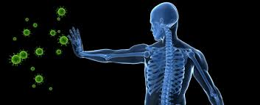
IMMUNE SYSTEM
Chapter 45

Slide 2
Immune system
Primary defense against disease-causing microorganisms

Slide 3
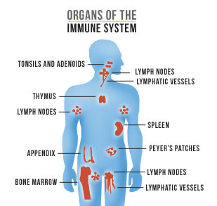
Organs involved
Lymph nodes
Filter/trap foreign particles; store B & T cells
Spleen
Stores blood cells; removes antibody coated cells
Adenoids (tonsils)
Trap bacteria/antigens
Bone marrow
Stem cells make blood cells; B lymphocytes mature here
Thymus
Produce and “educate” T lymphocytes

Slide 4
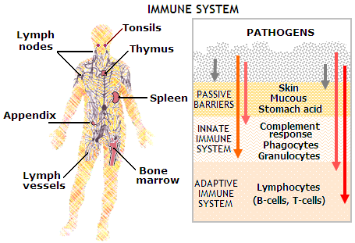
Lines of defense
There is 2 types of immunity
non specific innate immunity
specific acquired immunity
Within these there are 3 lines of defense
First line of defense
Second line of defense
Third line of defense

Slide 5
Non Specific innate immunity
Born with ability; treats all pathogens same
Has both the first line and second line of defense

Slide 6
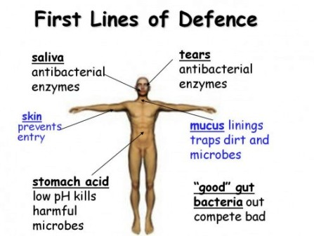
First line of defense = external
Skin – epithelial tissue; flat with tight junctions protective barrier
Mucous membranes – mucous; mouth, nose, anus openings
Cilia – line respiratory tract to sweep out invaders
Mucus – traps invaders
Secretions
Oils, HCl in stomach, enzymes, sweat glands

Slide 7
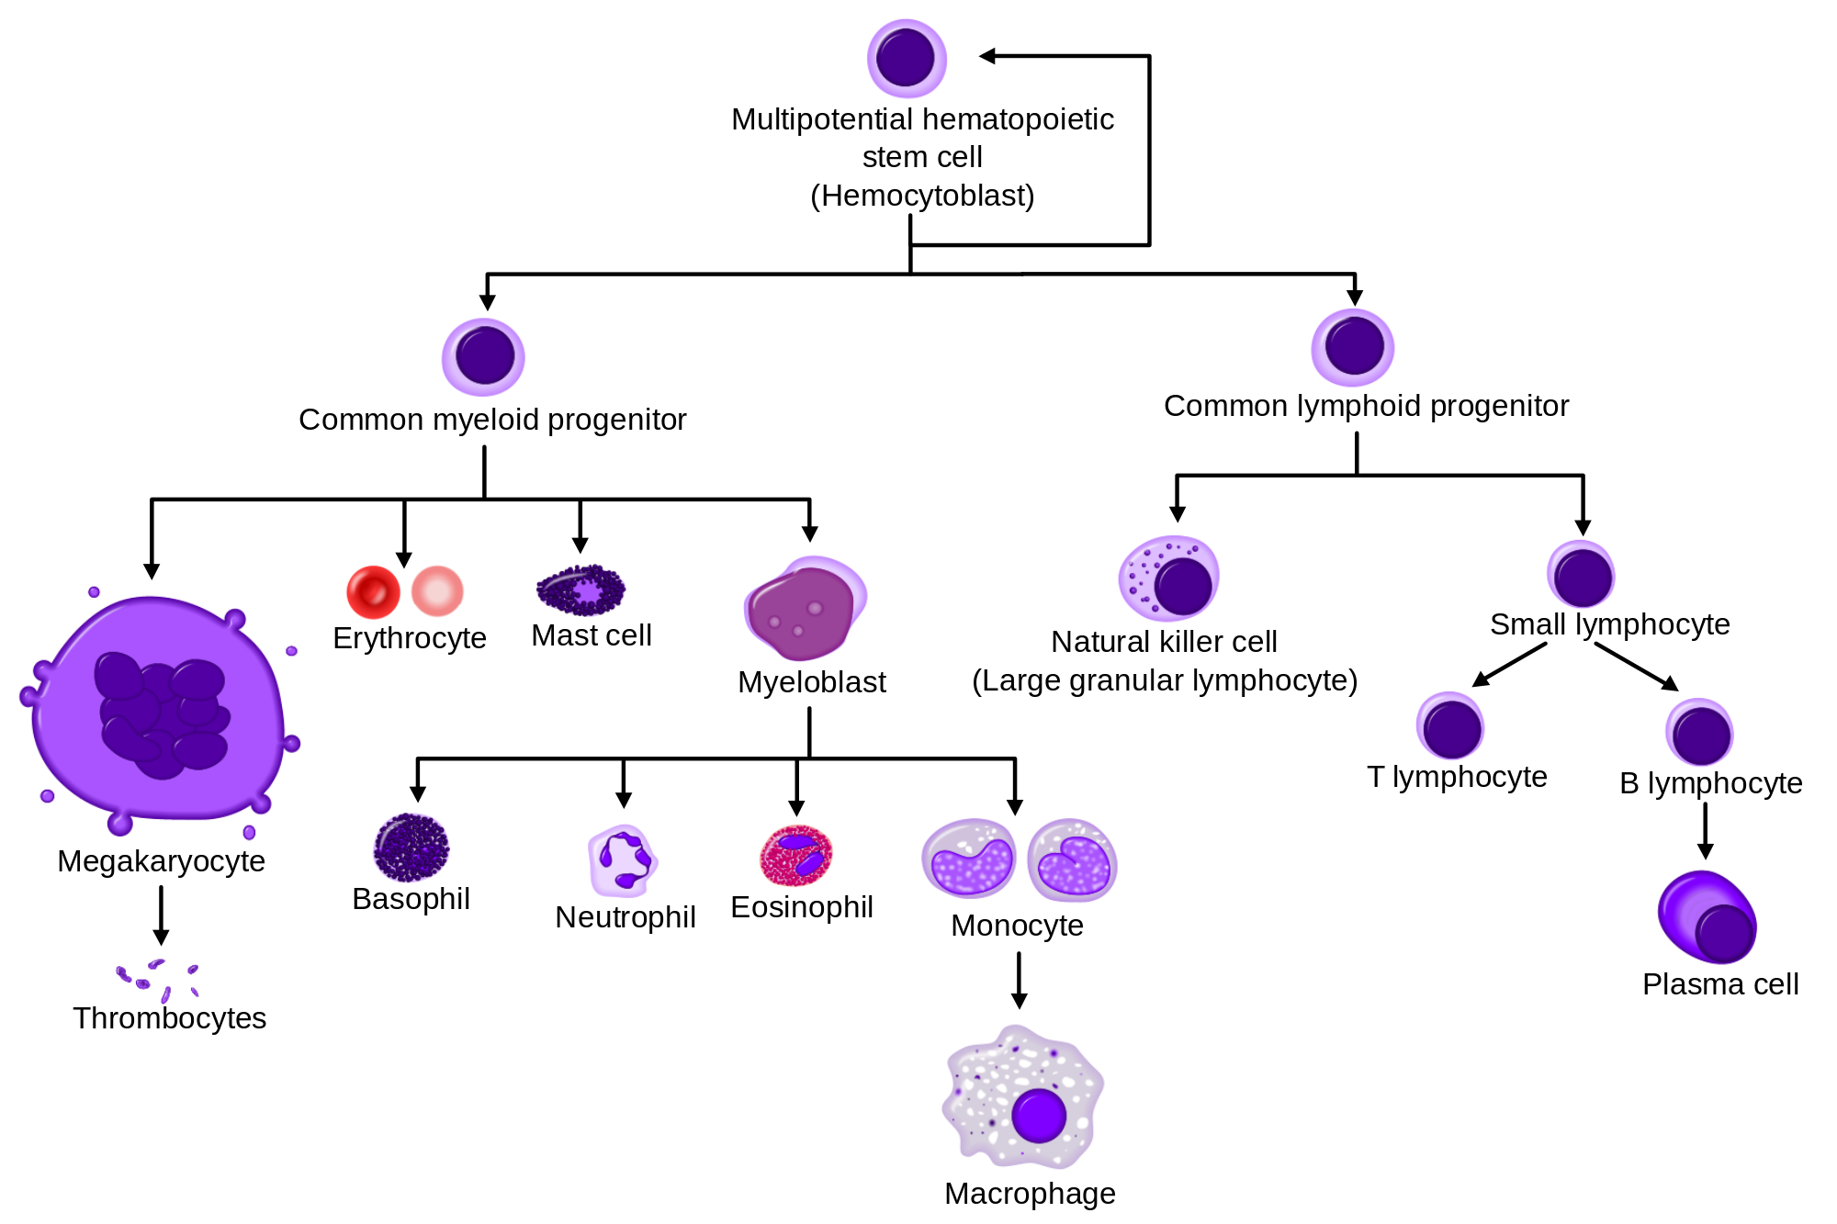
Second line of defense – internal
Leukocytes (Phagocytic cells) – type of white blood cell (WBCs)
Engulf and digest invading bacteria and virus also destroy any damaged WBC/tissue
Types:
Neutrophils
Macrophages
Eosinophils
Dentritic cells

Slide 8
Second line of defense – internal
Antimicrobial proteins (part of complement system)
Complement proteins – lyse infected cells; trigger inflammation (red, swelling, fever, pain)
Interferon response to viral infections:
Quarantines/protects nearby healthy cells from getting infected: activates macrophages to come and eat infected cells

Slide 9
Second line of defense – internal
Inflammatory Response (Heat, swollen, fever, red, pain)
Due to increased blood flow to area to bring more immune cells: response to chemicals in damaged area
Histamine released by mast cells: dilates blood vessels, brings more blood to infected area
Taking cold medications (antihistamine) counteracts histamine… when you have a cold/runny nose
Chemokines – chemical signals call up macrophages

Slide 10
Second line of defense – internal
Natural Killer Cells
Viruses and cancer cells not for bacteria
Trigger apoptosis – the death in infected cells

Slide 11
Specific Acquired Immunity
Gain this immunity over time
This is the third line of defense

Slide 12
Third Line of defense
Humoral immune response (Plasma Cells) – important in bacterial infections
B Lymphocytes (B cells) make antibodies (proteins)
Antibodies weaken pathogens and mark for phagocytic cells to “eat”

Slide 13
Third Line of defense
Cell-mediated immune response – important in viruses, cancer, transplants
Uses T lymphocytes (T cells)
Made in the bone marrow but become T cells in the thymus
Cytotoxic (Killer) T cells – recognize protein antigens on surface of virus infected cells; release chemicals
Perforins, granzymes
Helper T cells – activate B cells and Killer T cells
Suppressor Cells – maintain immune system homeostasis; tolerance to self-antigens

Slide 14
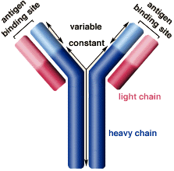
Third Line of defense
Antibodies – body makes millions of different antibodies
Shaped like a Y and has 2 identical antigen-binding sites that fit a specific antigen (like a lock and key)
Released into blood by the B cells
Each cell only makes one specific type of antibody
When antigen is recognized, cell reproduces rapidly to make more antibodies

Slide 15
Third Line of defense
Attachment of antibody to antigen releases: Complement Proteins
Circulate in blood
Activated by antibodies binding to antigens
Punch holes in cell walls of bacteria so they leak and die
Memory cells – created by exposure of B and T cells to antigens… “remembering” the antigen causes increased speed of response if exposed again

Slide 16
Immune System video
https://www.youtube.com/watch?v=P7o-wBzh6cw

Slide 17
Primary line
of defense
Secondary line
of defense
Tertiary line
of defense
tears
phagocytic
white blood
cells “eat” the
virus
skin
mucous membranes
white blood
cells (lymph-
ocytes)
produce
antibodies
Yum!
phagocyte
(see next slide)
virus

Slide 18
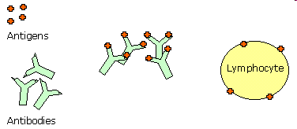
1. “bad guys” like viruses
2. antigen binds
to lymphocyte,
which stimulates
antibody
production
3. antibodies “bind” to antigens, thereby
rendering them incapacitated

