Slide 1
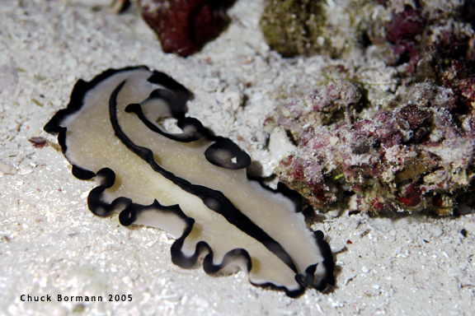
26-4 Unsegmented Worms

Slide 2
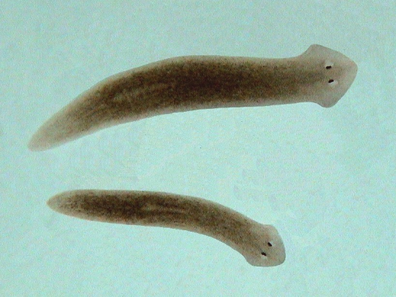
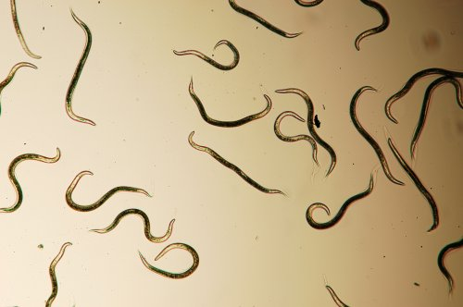
I. Unsegmented Worms:
A. (def’n): Bodies are not divided into special segments
B.Divided into 2 phyla:
1.Platyhelminthes (Flatworms)
Platy = flat;
Helminth = worm
2. Nematoda (Roundworms)

Slide 3
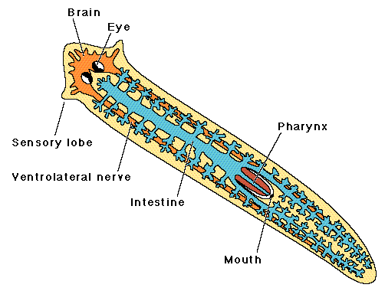
II. Flatworms Shape of Life VIDEO
A. Characteristics
Symmetry: Bilateral symmetry
2.Exhibit cephalization (Have a “head”)

Slide 4
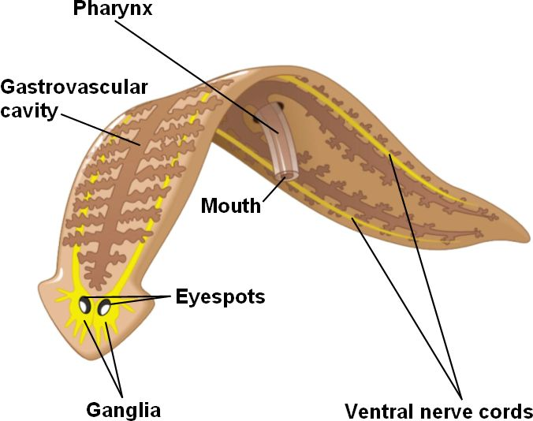
III.Form and Function in Flatworms
A. Describe how a free-living flatworm ( like
Planarian) eats:
Use their pharynx to suck food into the gastrovascular cavity

Slide 5
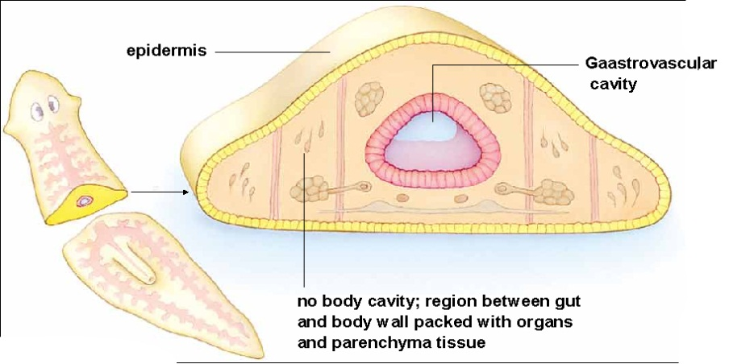
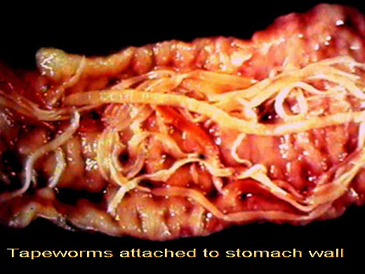
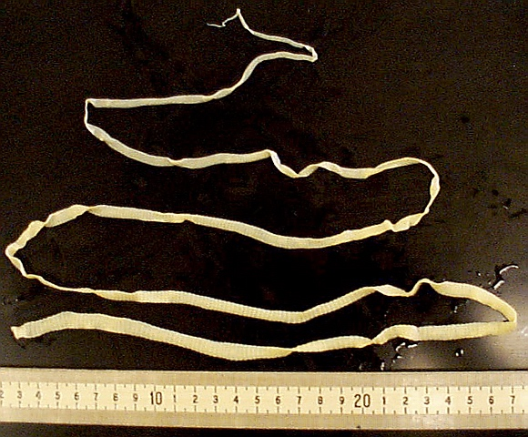
B. Why do tapeworms not have a g-v cavity?
They can absorb the predigested food in the host’s digestive tract

Slide 6
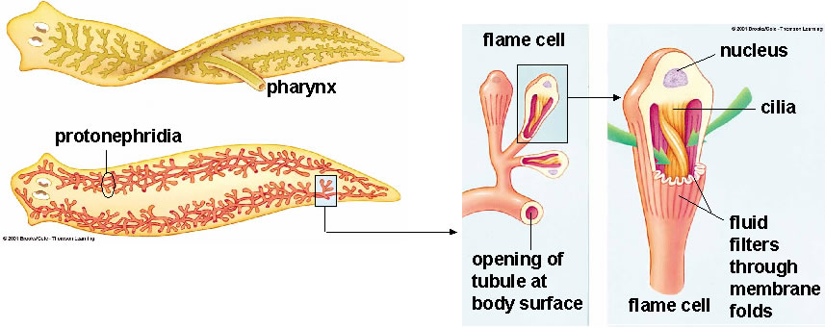
C. Circulatory and respiratory system:
1. Why do flatworms have no specialized circulatory or respiratory system?
They are able to diffuse the material into and out through their body walls.
2. What special structures do freshwater flatworms have?
Flame cells to help get rid of extra water

Slide 7
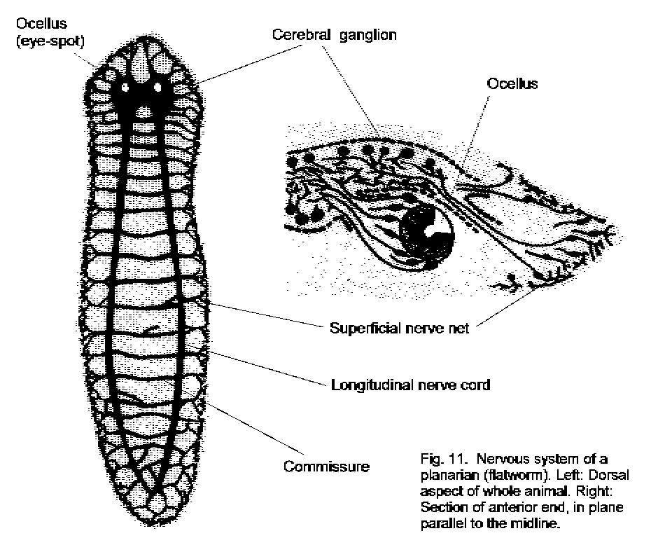
D. Nervous system
1. Brain: Located in the head
2. Nerve cord: Run from the brain down the length of the body on either side
3. Eyes: Ocelli can detect light or dark
4. Chemical sensors: Can find food and tell the direction of water flow

Slide 8
How does their nervous system help free-living flatworms?
Helps it locate food and to find dark hiding places beneath stones and logs during the day
Why do parasitic flatworms not have much of a nervous system?
Because they mainly hang onto an intestinal wall and absorb food—a much less demanding lifestyle

Slide 9
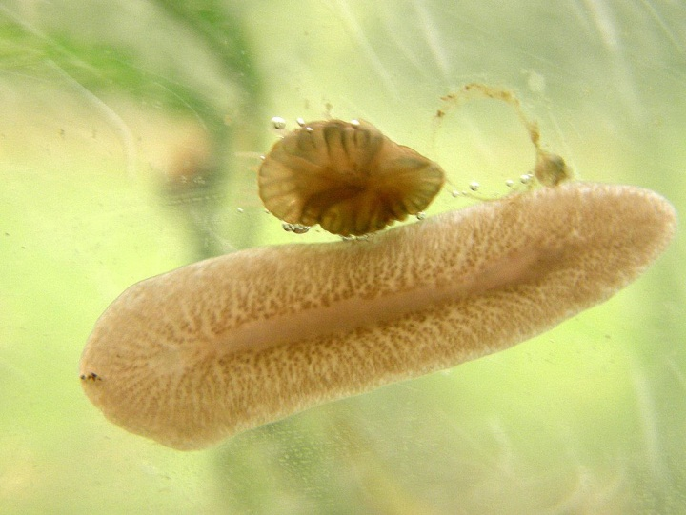
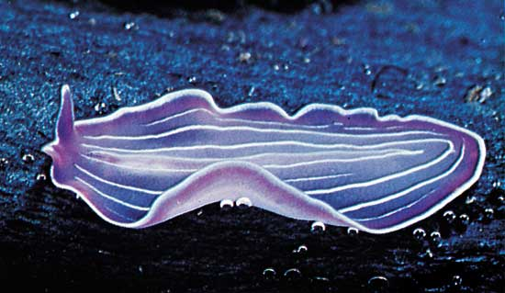
E. Locomotion
1. 2 methods of locomotion at once:
a. Cilia to help glide through the water and over the bottom
b. Muscle cells allow them to twist and turn to react rapidly

Slide 10
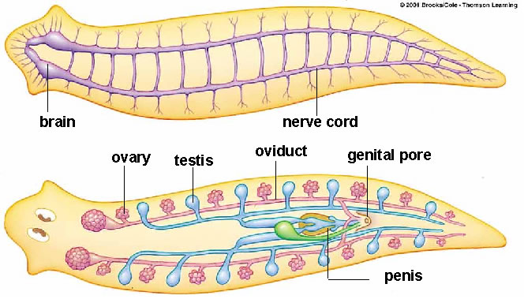
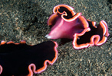
F. Reproduction
1. Hermaphrodites: Organisms has both male and female organs
2. Describe how flatworms reproduce
a) Sexually: The worms join in pairs. One worm delivers sperm to the other worm while receiving sperm from its partner at the same time. The eggs laid in small clusters, hatch within a few weeks.

Slide 11
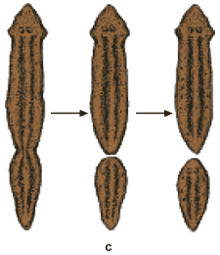
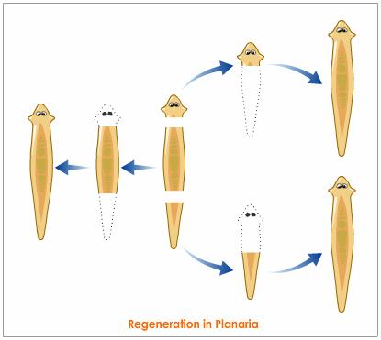
b) Asexually: Regeneration

Slide 12
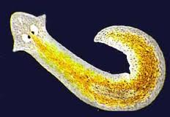
G. Planarians
1. Description: “Cross-eyed” and can vary
in color, form and size
2. Habitat: Freshwater

Slide 13
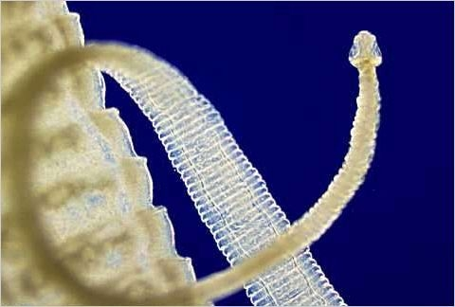
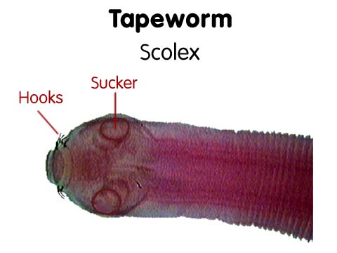
H. Tapeworms
Description: Head called a scolex on which there are several suckers and a ring of hooks
Moving tapeworm

Slide 14
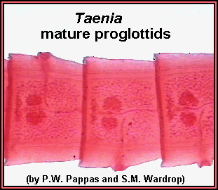
2. Reproduction
Proglottid: Section that makes up most of the body of the tapeworm
Lifecycle Video

Slide 15
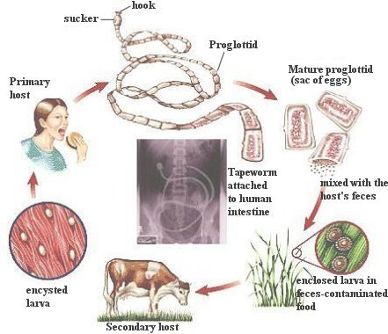
Describe how tapeworms reproduce and how their eggs get out of the host:
Sperm produced by the testes can fertilize eggs in the proglottids of other tapeworms or in the same individual. Fertilized tapeworm eggs are released when mature proglottids break off the posterior end of the tapeworm and burst open.
A mature proglottid may rupture either in the host’s intestine or after it has been passed out of the host’s body with the feces

Slide 16
Describe how tapeworm eggs get into their intermediate host and then back to a human:
If food or water contaminated with tapeworm eggs is consumed by cows, pigs, or fish, the eggs enter these intermediate hosts and there hatch into larvae. These larvae grow for a time and then burrow into the muscle tissue of the intermediate host and form a dormant protective stage called a cyst.
If a human eats raw or completely cooked meat containing these cysts, the larvae become active within the human. Once inside the intestine of the new (human) host, they latch onto the intestinal wall and grow into adult worms.

Slide 17
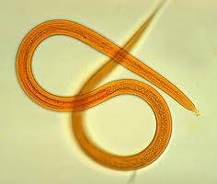
IV. Roundworms
Phylum: Nematoda
1. Simplest animals to have a digestive system with two openings - a mouth and an anus. Food enters through the mouth, and undigested food leaves through the anus.
2. Size: Microscopic to a meter in length

Slide 18
V. Form and Function in Roundworms
A. Digestive System
2 feeding methods:
a. Free-living b. Parasitic
2.Physical description of the digestive system
a. Sketch figure 26-32
b. How does digestion work in roundworms? Food enters through the mouth and continue straight through the digestive tract. Any undigested material leaves through an anus

Slide 19
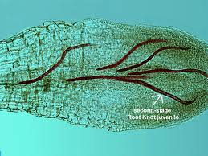
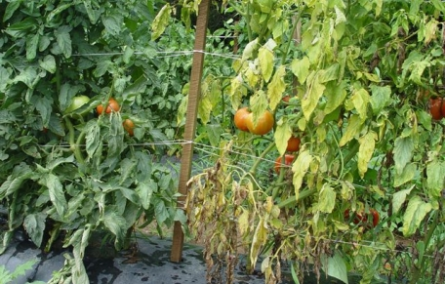
3. Food:
a. Small animals
b. Small algae, fungi or pieces of decaying organic matter
c. Bacteria and fungi that break down dead animals and plants
Plant juices
Give an example of how roundworms cause damage to plants.
Tomato plant

Slide 20
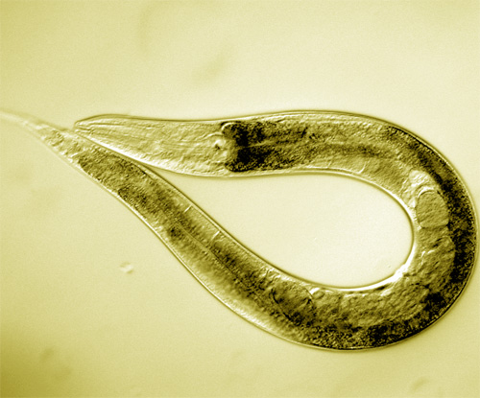
B. Circulatory and Respiratory System
1. Respiration: Diffusion through the body walls
2. Excretion: Diffusion through the body
walls

Slide 21
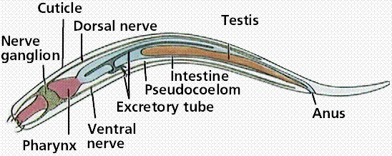
C. Nervous System
1. Brain: Several ganglia
2. Nerve cord: Several that extends from
the ganglia down the body
3. Chemical sensor: Can detect chemicals given off by prey or hosts.

Slide 22
D. Locomotion
1. Structure of muscles: Run in strips down the length of their body walls
2. Describe how roundworms move.
Aquatic roundworms contract these muscles to move like snakes through the water. Soil-dwelling roundworms push their way though the soil by thrashing around.
Roundworms in Opussom
Roundworms in a cats intestine
Pinworm infection in children

Slide 23
E. Reproduction
1. Method: Sexually
2. Describe how roundworms reproduce.
Fertilization takes place inside the body of the female. Eggs are produced

Slide 24
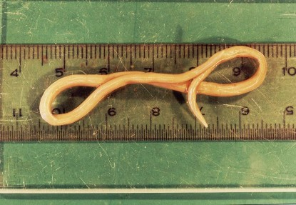
G. Ascaris
Describe how Ascaris can affect humans.
Can live in humans!
Giant intestinal roundworms are a serious pig and human parasite in tropical areas with poor sanitation.

Slide 25
2. How does it reproduce in the human body?
The worms live in the intestines, where they produce many eggs that leave the host’s body in the feces. If food or water contaminated with these feces is eaten by another host, the eggs hatch in the small intestine of the new host. The young worms burrow into the walls of the intestines and enter surrounding blood vessels. They are carried around in the blood and end up in the lungs. Here they break out into the air passages and climb up into the throat, where they are swallowed. Carried back into the intestine, they mature and the cycle repeats.

Slide 26
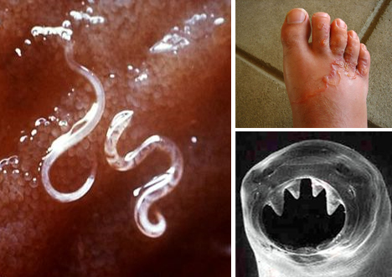
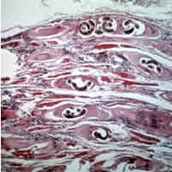
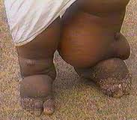
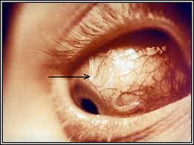
VI. How Unsegmented Worms Fit into the World
A. 4 examples of parasitic worms and how they affect humans:
1. Hookworms suck the blood out of the host’s intestinal wall. It can cause weakness and poor growth
2. Trichinosis burrow into organs and tissue of the host. It cause terrible pain.
3. Filarial worms can block passages of fluids in the lymph vessels. This cause elephantiasis.
4. Eye worms live and burrow through the tissue below the skin of their host. It can move across the surface of the eyes.

